Slide 1
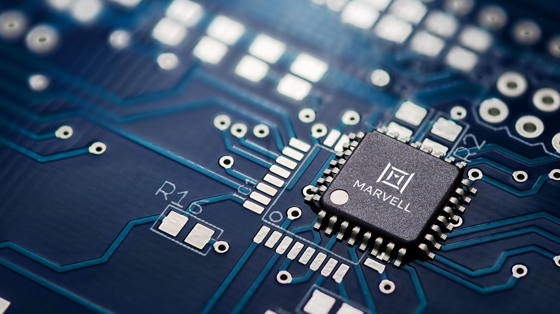
CE AMS SerDes IP
FAE Training 2022
© 2022 Marvell confidential. All rights reserved.
1

Slide 2

Legal Statement:
CONFIDENTIAL INFORMATION
The information contained in this presentation is the confidential and proprietary information of Marvell. You are not permitted to disseminate or use any of the information provided to you in this presentation outside of Marvell.
This material MUST NOT be distributed to customers

Slide 3
Training Outline
1 | 5nm 112G COMPHY Architecture
2 | 5nm 112G COMPHY Function
3 | 5nm 112G COMPHY DSP Training
4 | 5nm 112G COMPHY Firmware
5 | 5nm 112G COMPHY IBIS-AMI Model
6 | 5nm 112G COMPHY MCESD/API
7 | 5nm 112G COMPHY AE Guidelines

Slide 4
Time | Topic | Presenter
8:00 – 8:15 | Get to know the team | All
8:15 – 8:35 | Introduction | Mike Sorna
8:35 – 09:35 | Architecture - RX | Fang Dong
9:35 – 10:05 | Architecture - RX Q&A section
10:05 – 10:20 | Break
10:20 – 10:50 | Architecture - PLL | Eugene Kim
10:50 – 11:00 | Architecture – PLL Q&A section
11:00 – 11:15 | Break
11:15 – 11:35 | IBIS-AMI Model | Evelina Zhang
11:35 – 11:50 | IBIS-AMI model Q&A section
11:50 – 12:30 | Lunch
AGENDA

Slide 5
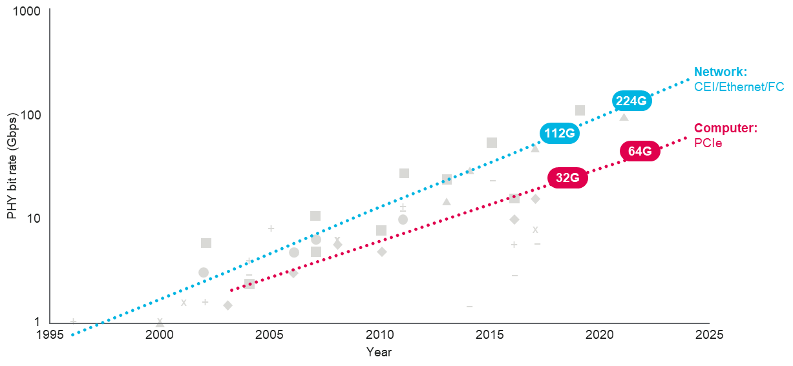
5 nm COMPHY_112G_ADC Introduction
Ever-increasing demand of higher I/O bandwidth for infrastructure
PAM-4 signaling has been adopted for higher bandwidth efficiency
Carrier
Supercomputer
5G
Enterprise
Automotive
SerDes
Storage
High Def. video conference
Data Center

Slide 6
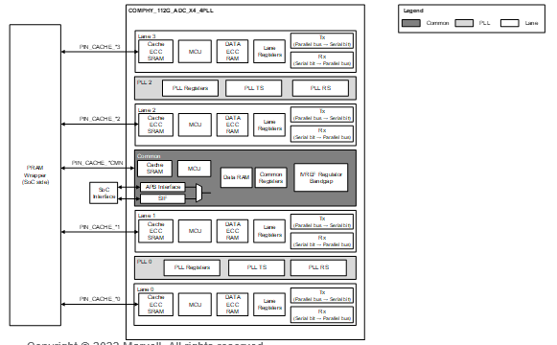
5 nm 112G SerDes
Key Features:
Configurable bus widths with PAM2 and PAM4 modulation:
PAM2: 32-/40-bit for ≤ 32 Gbps and 64-/80-bit for > 32 Gbps
PAM4: 64-/80-bit for ≤ 56.25 Gbps and 128-/160-bit for > 56.25 Gbps
Tx: 6 tap equalization, 2 post-taps, and 3 pre-taps
Rx:
Supports > 40 dB loss at 112 Gbps with optimized firmware-based training
6 pre-taps, 16 post-taps and 8 floating taps
1-tap Decision Feedback Equalization (DFE) or 1+D mode to support long reach and reduce burst error and Forward Error Correction (FEC) performance
Programmable Analog-to-Digital Converter (ADC) resolution to support lower data rates with better power efficiency
Least Mean Square (LMS) adaptation to maintain optimum performance with different operating duty cycles to optimize power
Real-time Eye Opening Measurement (EOM) monitor
Real-time PRBS-pattern FEC error histogram with post-FEC BER
Real-time SNR at digital slicer averaged or by PAM4 symbol level
Real-time Single Bit Response (SBR) estimation at ADC input
Built-in temperature/process monitor with advanced compensation schemes
Test Chip Status:
R1.0 included in STC05-R3, silicon arrived in March 2022
R1.1 included in ASIC BU SoC, tapeout targeted for December 2022
Application | Next-generation solution focused on 800G applications, interoperability, and backward compatibility
Data Rates | 1.0625 to 56.0 Gbps (NRZ); 32.5 to 112.5 Gbps (PAM4)
Configurations | X1 (2-PLL variants), X4 (4-PLL variants)
AVDD/DVDD Range | 1.2V -19%/+3% / 0.75V -3%/+10%
Temperature Range | -40⁰C to 125⁰C
Power (Typical) | 530 mW/lane at 106 Gbps long reach (1 active PLL/lane)
Area | 1.905 mm²; 1363 µm (W) x 1397 µm (H); 4-port/4-PLL

Slide 7
COMPHY_112G_ADC
IP of the COMPHY (Common PHY) family for 112G LR application
Provides an aggressive analog + digital power/area while maintaining top-notch performance
Application: Switch, PHY, ASICs
Main networking standards
Ethernet: IEEE 802.3ck - PAM4 106.25Gb/s - 100G Backplane (KR) and Cable (CR)
OIF: Common Electrical I/O (CEI) 112G - Long Reach (LR)
50G mode: IEEE 802.3cd – PAM4 53.125 Gb/s (+OIF)
25G mode: IEEE 802.3bj – NRZ 25.78125 Gb/s (+OIF)
10G mode: IEEE 802.3ap – NRZ 10.315 Gb/s (+OIF)
Down to 1G speed

Slide 8
Marvell Backplane Core Offering Matrix
Core | Tech | 1-Port Core | 2-Port Core | 4-Port Core
 |  | 2-PLL (X/Y) | 2-PLL (X/Y) | 2-PLL (X/Y) | 4-PLL (X/Y) | 5-PLL (X/Y)
64G LR | N7 | 1.10mm x 0.56mm | 1.19mm x 0.79mm | 1.30mm x 1.27mm | 1.205mm x 1.434mm^{1a} | N/A
112G LR | N7 | N/A | N/A | 2.06mm x 1.23mm | 1.74mm x 1.40mm | N/A
32G | N5 | 0.846mm x 0.568mm | 0.87mm x 0.82mm | 0.846mm x 1.287mm | 0.835mm x 1.484mm | N/A
64G LR | N5 | 0.935mm x 0.546mm^{1a} | 0.96mm x 0.79mm | 1.03mm x 1.27mm | 0.935mm x 1.433mm^{1a} 0.989mm x 1.433mm^{1b} | N/A
112G LR | N5 | 1.363mm x 0.534mm | N/A | N/A | 1.363mm x 1.398mm 1.563mm x 1.398mm² | 1.380mm x 1.290mm^{3a} 1.260mm x 1.610mm^{3b}
112G XSR | N5 | N/A | N/A | 8-Port/1-PLL: 1.492mm x 1.189mm 16-Port/1-PLL: 1.62mm x 2.10mm
Note:
Support PCIe Gen5 (1a) and PCIe Gen6 (1b)
N5 112G LR 4-Port core 4-PLL with Repeater
N5 112G LR 4-Port core 5-PLL in E/W (3a) and N/S (3b) orientation
Sizes highlighted in RED are currently under development. Other sizes are estimates and will be considered for development if approved by top management
N7 112G LR core development on HOLD
32G core for 4-Port/2-PLL and 1-Port/2-PLL are w/o PIPE (does not support PCIe)

Slide 9
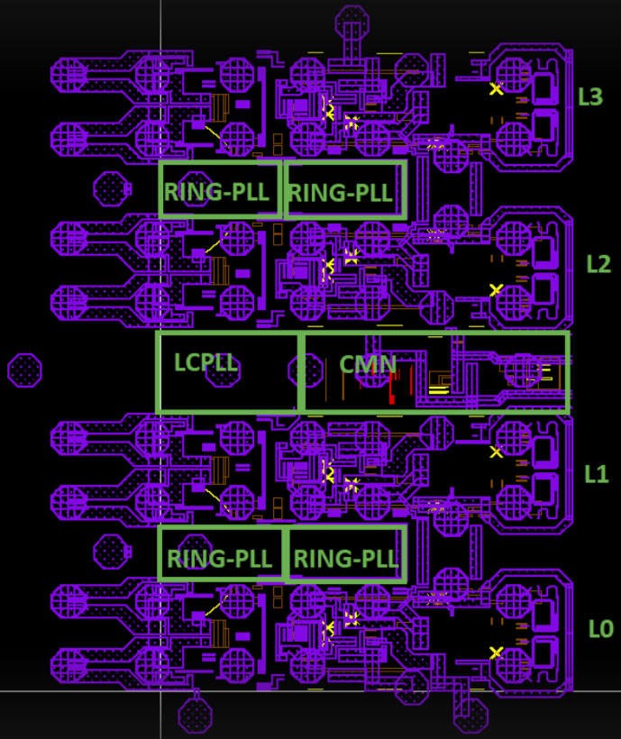
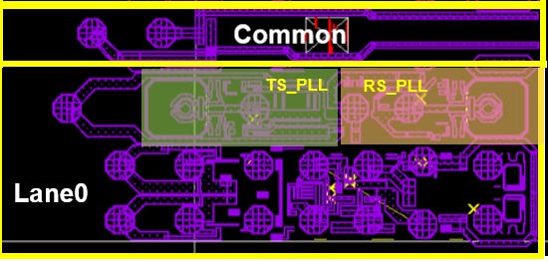
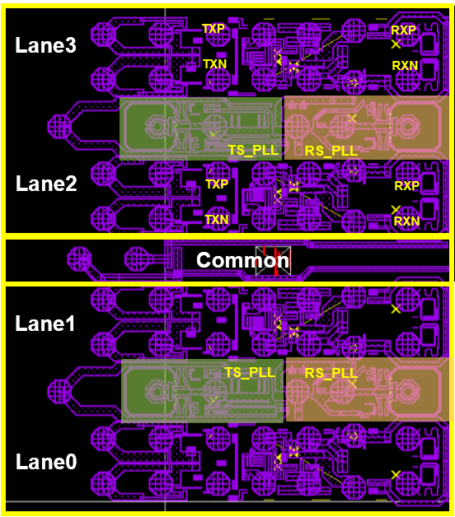
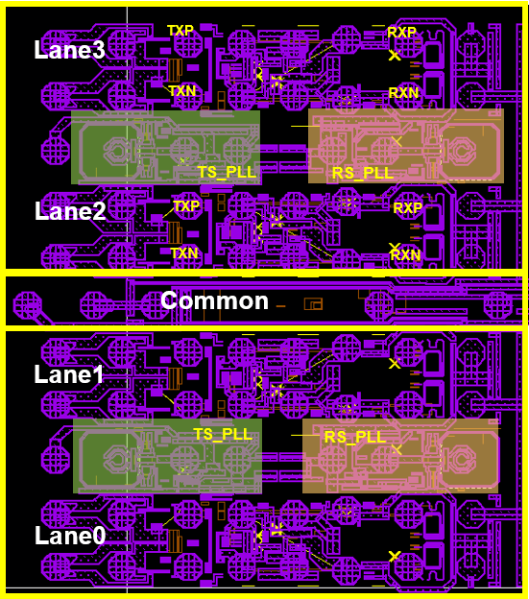
Core Configurations:
4-port / 4 PLL (Repeater)
1-port / 2 PLL
4-port / 4 PLL
4-port / 5 PLL
Lane3
Lane2
Lane1
Lane0

Slide 10
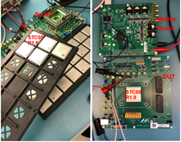
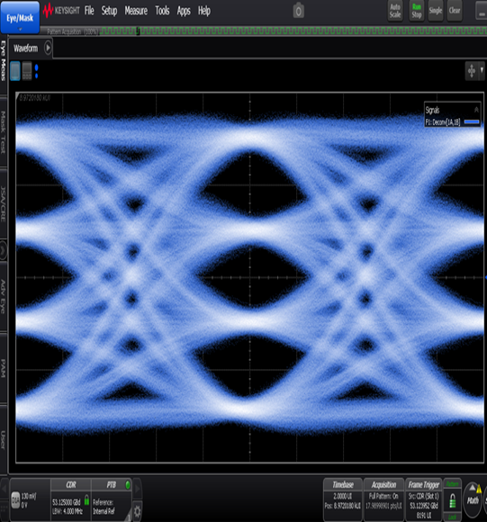
Silicon Proven 5nm SerDes IP
112 Gbps Testboard
112 Gbps SerDes IP
Numerous internal product tape-outs w/ 112G
112G core <1e⁻⁹ BER >37 dB channel
~150 fs RJ TT / <200 fs RJ over PVT

Slide 11
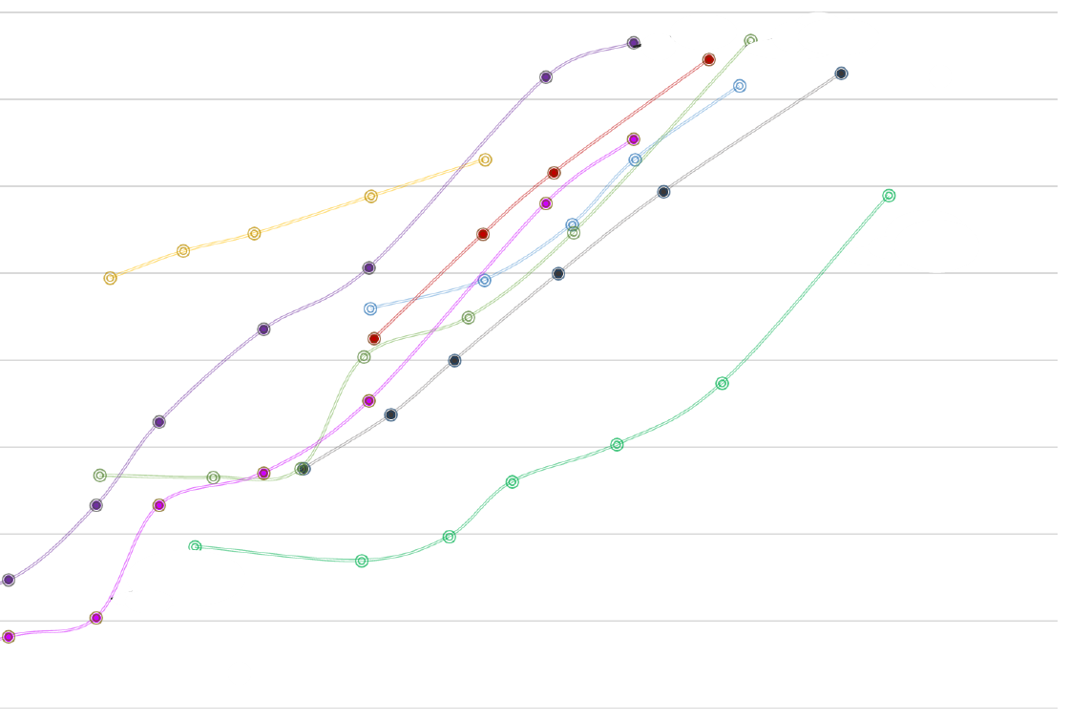
5nm 112G SerDes Performance: Cisco Evaluation
Cisco measurements:
Marvell 5nm 112G SerDes
IL: 40dB @ 1e-8 BER @4.9pJ/bit
NET – Marvell 112G LR has Industry Leading Performance
1e-4
Competitors
1e-5
1e-6
Bit Error Rate (BER)
1e-7
1e-8
Marvell 112G SerDes
(5nm)
BETTER
1e-9
1e-10
BETTER
26
31
36
41
46
51
Insertion Loss (dB)
Significant margin with respect to IEEE spec

Slide 12
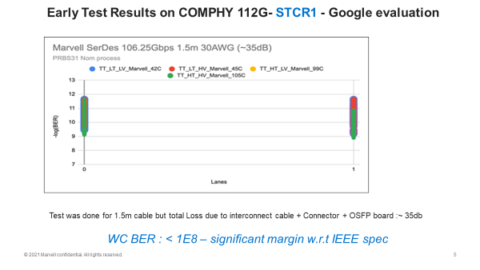
5nm 112G SerDes Performance: Google Evaluation

Slide 13
Top Level Block Diagrams
Quad macro
Shared common blocks
Dedicated PLL for each lane
DAC-based SST driver
High performance AFE
DSP based adaptive RX equalization
PIN_RX
PIN_TX

Slide 14
Sub-level Blocks Introduction
COMPHY_112G_ADC sub-level blocks
Tx
Rx
PLL
COMMON

Slide 15
5 nm COMPHY_112G_ADC Rx Architecture
Fang Dong
CE AMS Team
11/29/2022

Slide 16
COMPHY_112G_ADC Rx Overview
High bandwidth and low noise AFE with data rate supporting up to 112.5 Gbps
CTLE for pre-equalization
Timing Interleaved (TI) ADC for signal digitization
The Rx DSP in digital domain includes
A digital data-path for data recovery
A digital clock-path for clock recovery
Equalization adaptation engines
ADC calibration engines
Metric monitors
FW-based sophisticated training algorithm to optimize the performance across PVT

Slide 17
Analog vs ADC-Based SerDes:
 |  | ADC-Based | Analog | Comment
Equalization | Equalization capabilities | TX-FIR, CTLE, RX-FFE, DFE (1 tap) | TX-FIR, CTLE, DFE (multiple taps) | Challenges to achieve 1st DFE tap with analog SerDes at higher speeds
 | Precursor Cancellation | TX-FIR, RX-FFE | TX-FIR only | DFE can cancel only post-cursor ISI
 | Modulation Scalability | Easier to scale for higher order modulation | Harder to scale for higher order modulation | Complexity quickly grow with modulation in analog SerDes More DSP can be used in ADC SerDes
Timing Recovery |  | Baud-rate/oversampled higher latency | Bang-bang CDR (edge/data) lower latency | Mueller-Müller as Baud rate timing recovery
Power |  | Competitive in PAM4 Higher power in NRZ | Lower power | Smaller technology nodes improving efficiency of ADC SerDes
Process Sensitivity |  | Less process sensitive | Very sensitive to process | Analog SerDes requires precise calibration across PVT
Scaling |  | DSP portion scales well with technology node | Doesn’t scale well with technology node | Analog porting is re-design for both
Portability |  | Easier to port design | Harder to port design | Focus on digital side

Slide 18
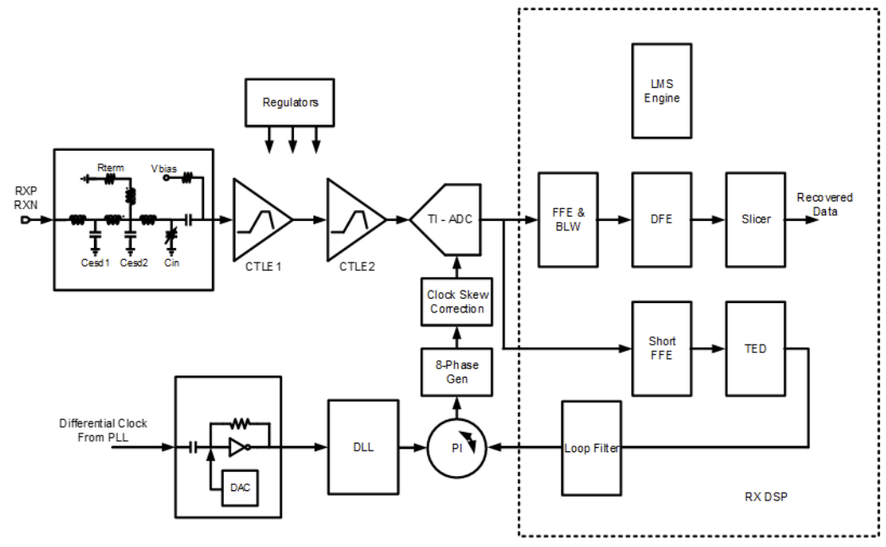
Rx Block Diagram

Slide 19
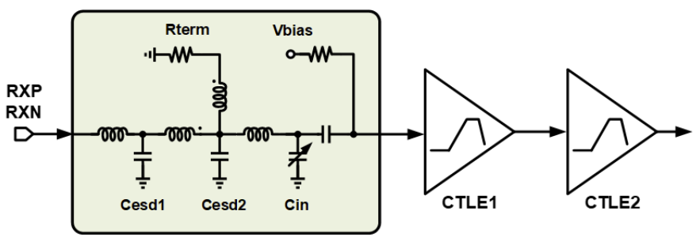
Rx Front-End
Input network bandwidth extension with inductors and t-coil
Variable capacitor for high frequency gain programmability
Impedance calibration
2-stage CTLE provides up to 18 dB peak gain

Slide 20
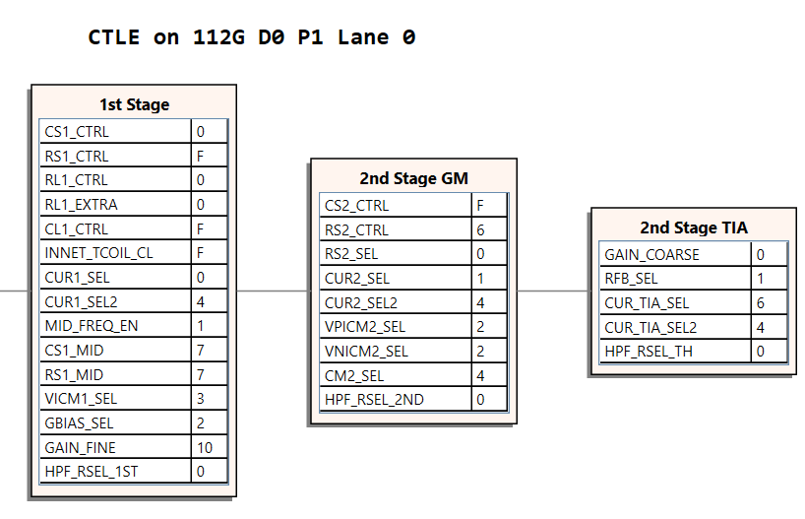
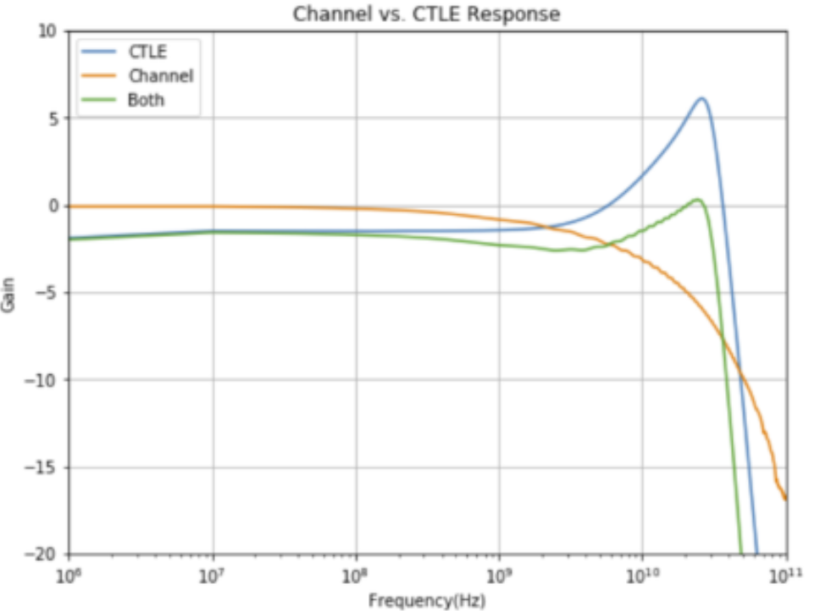
COMPHY_112G_ADC – RX CTLE
Continuous Time Linear Equalizer (CTLE)
2 cascaded equalization stages
providing 2 zeros and 4 poles

Slide 21
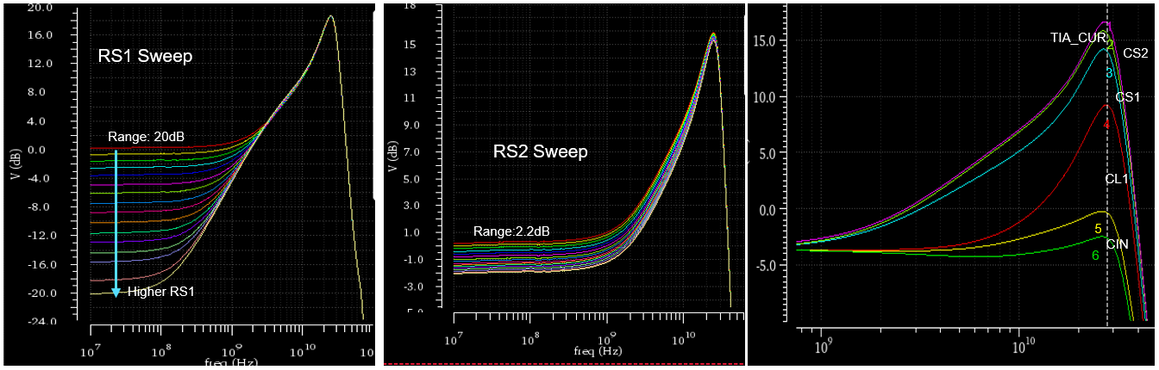
CTLE Gain Range
Total = 22.2 dB DC gain range
Peak Range = 19.1 dB

Slide 22
Rx Track and Hold (T/H) ADC
A0
8X8 interleaving
8 T/H sample + BUF
8 SAR per T/H bank
Buffer(1X)
SAR0
From CTLE
SW0
SAR56
A7
A0
SW1
Buffer(1X)
SAR1
SAR57
A7
A0
Buffer(1X)
SAR7
SW7
SAR63
A7

Slide 23
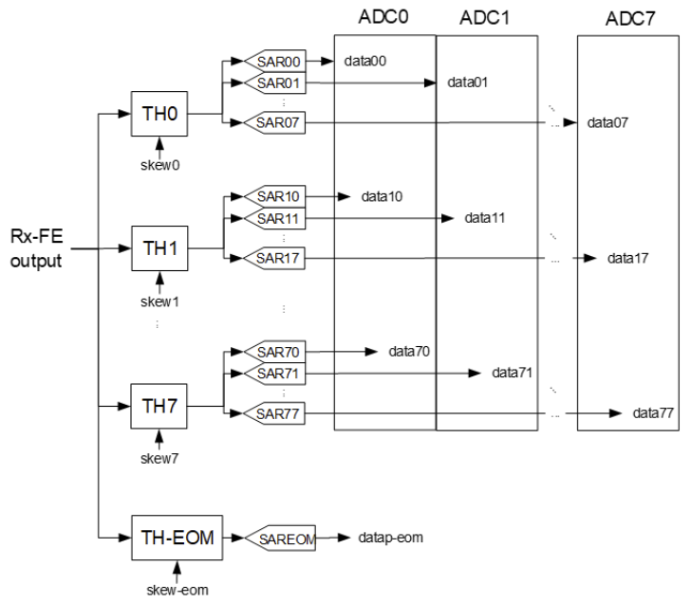
COMPHY_112G_ADC – TI-ADC
Structure/Resolution/Speed
8x8 Timing Interleaving, balance of complexity and power (64 Sub-ADC)
Programmable - 4~7bit,
Sampling speed - 3.5~56GS/s
Scalable/Adaptive supply
Scalable/Adaptive resolution
Scalable input Dynamic range (Performance control)
Scalable sub-ADC count (8/16/32/64 sub ADC)
Low power SAR with custom logic
Features for optimizing power
Background digital calibration engines
Offset, Gain and Skew calibration in digital domain
Simple, Flexible, Robust

Slide 24
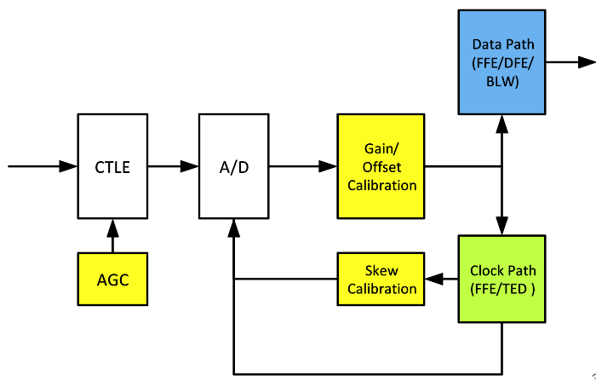
Rx Digital Block Calibrations
Gain/offset calibration
Remove the analog gain and offset mismatch of each separate ADC
Find the optimum gain coefficients which brings the average of the amplitude among different SAR to be equal
Remove the DC offset of each ADC
Skew calibration
Compensates the T/H sampling timing skew error
AGC
Adjust the ADC input dynamic range to fully utilize ADC resolution by reusing the ADC gain calibration target hardware

Slide 25
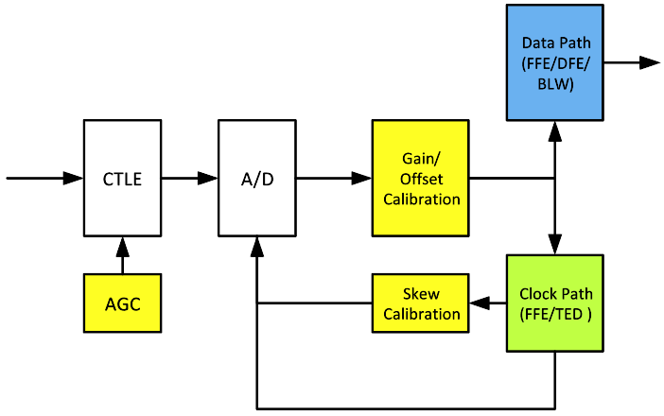
Rx Digital Block Calibration Registers
Gain/offset calibration
rx_adc_if_gain_word{0:63}_lane[5:0]
rx_adc_if_ofst_word{0:63}_lane[6:0]
Skew calibration
skew_adapt{0:7}_lane[8:0]
AGC
rx_adc_if_agc_gain_lane[4:0]
Calibration | Resolution | Range
Offset | ¼ ADC LSb | ±16 LSb
Gain | 1/128 | ±25%
Skew | 50 fs | ±4 ps

Slide 26
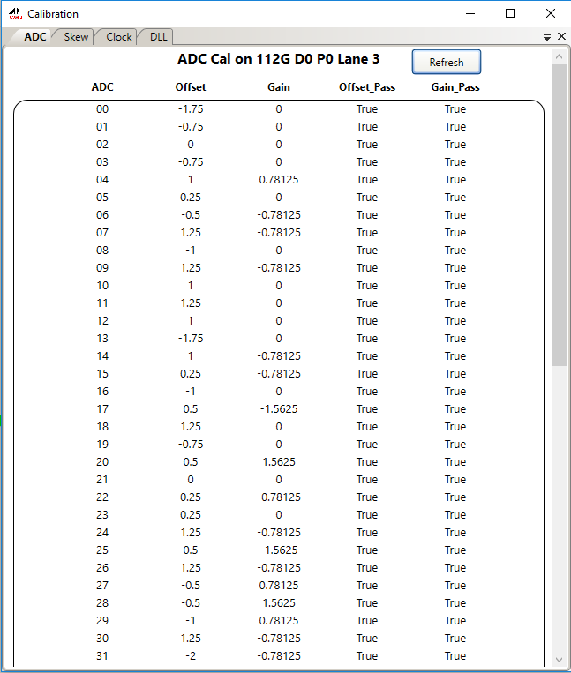
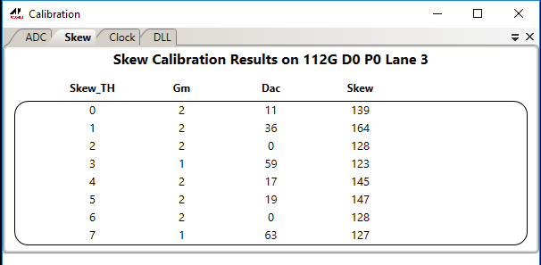
COMPHY_112G_ADC ADC Calibrations
ADC calibration results on Raptor2 GUI

Slide 27
ADC Configuration Depending on Speed
Speed mode | Sampling rate (GSamp/s) | Clock rate (GHz) | Over-sampling | #THs
112G-PAM4 | 50 - 56 | 12.5 - 14 | None | 8
56G-NRZ
56G-PAM4 | 14 - 28 | 7 - 14 | None | 4
28G-NRZ
10G (NRZ) | 7 - 14 | 7 - 14 | None | 2
5G (NRZ) | 3.5 - 7 | 7 - 14 | None | 1
3G (NRZ) | 3.5 - 7 | 7 - 14 | x2 | 1
1G (NRZ) | 3.5 - 7 | 7 - 14 | x4 | 1

Slide 28
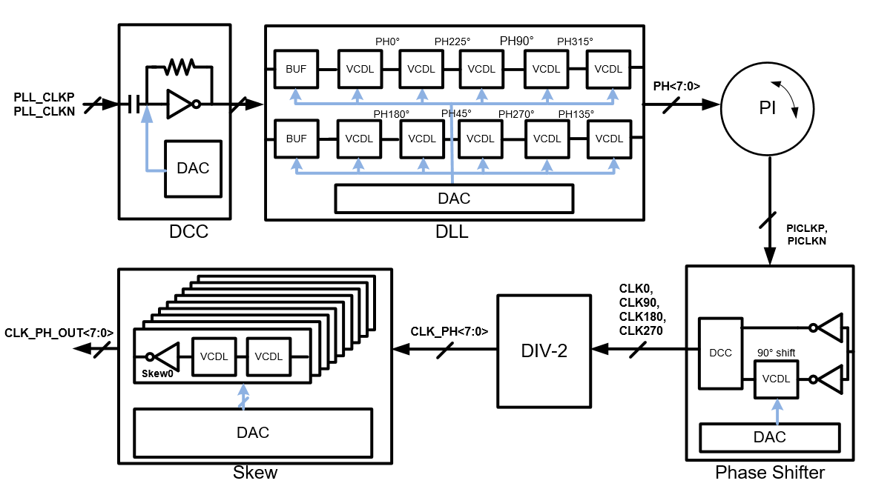
Rx Clock Generation
8-bit Phase Interpolator (PI) is driven by the clock recovery loop
8-phase clock for T/H with skew compensation

Slide 29
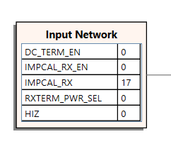
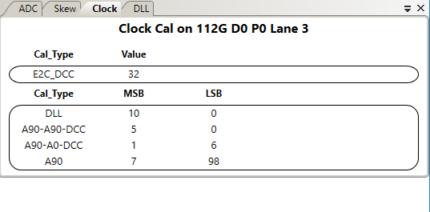
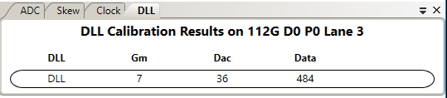
RX Analog Calibration
RX impedance calibration (one time calibration)
Target to 50Ω single end
RX dcc-align90 calibration (continuous calibration)
Data clock duty cycle correction
Multi-phase generation calibration
Data clock phase alignment calibration

Slide 30
Rx Digital Data Path
Data path equalization
Feed Forward Equalizer (FFE)
Decision Feedback Equalizer (DFE)
Data path bus width conversion (gear box)
Convert analog bus width to SoC bus width
Gear box (not shown in the plot)
The slicer output goes to gear box then to SoC

Slide 31
Rx Data Path FFE
M-tap FFE
Provides a linear FIR block to better equalize the channel loss
Process ADC samples to remove pre-cursor and post-cursor ISI
FFE supports 6 pre-taps, 16 post-taps and 8 floating-taps cover up to 120 UI
FFE tap adaptation is achieved with sign-error LMS adaptation engines
This block includes gain and BLW offset compensate logic
Speed mode | # FFE precursors | # FFE postcursors | FFE floating taps
112G/56G/28G | 6 | 16 | Yes
10G | 4 | 10 | Yes
5G | 2 | 5 | Yes
3G/1G | 1 | 2 | No
Notes:
BLW

Slide 32
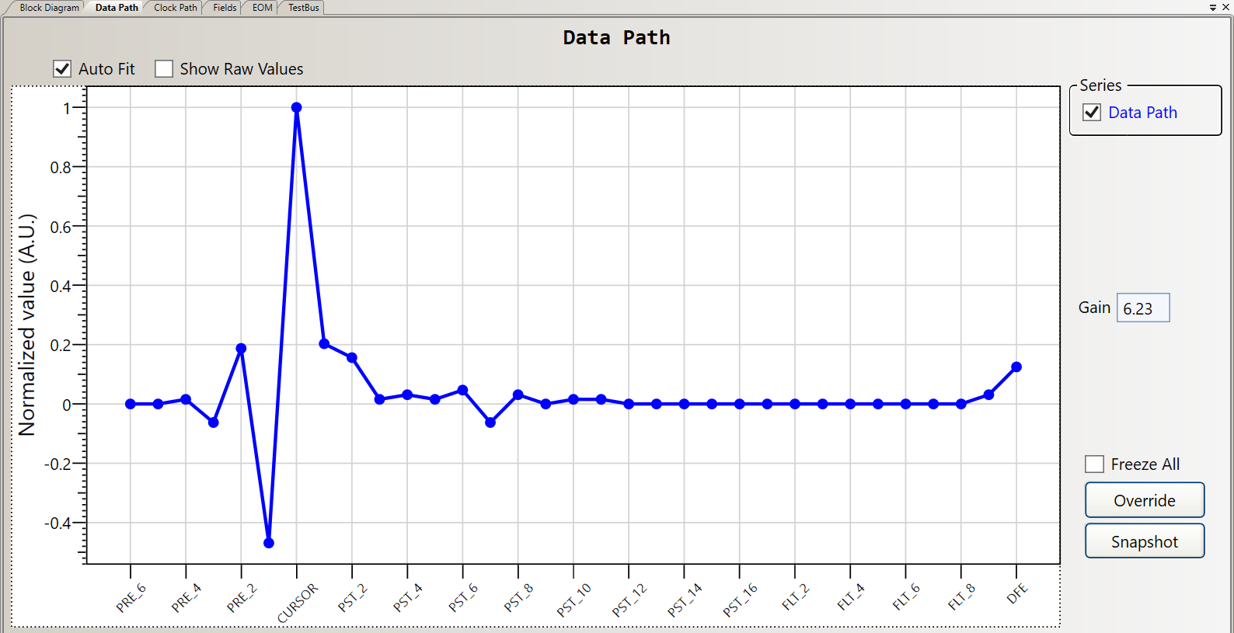
FFE Key Registers
DP FFE key registers
rx_dp_lms_ffe_pre{6:1}_coe_lane[2:0]
rx_dp_lms_ffe_pst{1:16}_coe_lane[6:0]
rx_dp_lms_ffe_flt{1:4}_b0_coe_lane[2:0]
rx_dp_lms_ffe_flt{1:4}_b1_coe_lane[2:0]
rx_dp_lms_gain_coe_lane[10:0]
rx_dp_lms_blw_coe_lane[5:0]

Slide 33
Rx Data Path DFE
1-tap unrolled DFE
Output symbol level at the slicer are +3, +1, -1, and -3 in PAM4 and +3 and -3 in PAM2
DFE tap adaptation is achieved with LMS adaptation engines
DFE key registers
rx_dp_lms_dfe_coe_lane[5:0]
Notes:
BLW

Slide 34
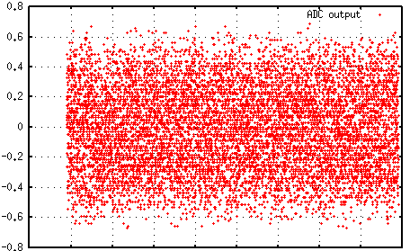
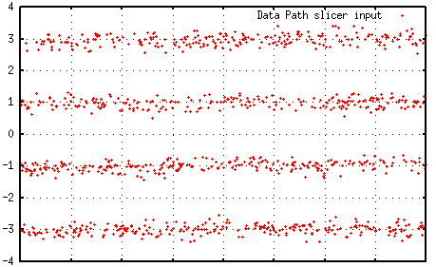
Rx Data Path FFE + DFE
ADC output
FFE + DFE
Data path slicer input
top-th
Normalized Unit (+/-1.0)
Digital value
mid-th
bot-th
time
time
Notes:
BLW

Slide 35
Rx Digital Clock Path
DTL-FFE with 6 taps
TED (timing error detector)
Loop filter
Phase integrator

Slide 36
COMPHY_112G_ADC – RX Clock Path FFE
Provides a Finite Impulse Response (FIR) block to better equalize the channel loss.
This block includes gain and BLW offset compensate logic.
It is a simplified version of data path FFE. The FIR FFE supports 3 pre-tap and 3 post-tap

Slide 37
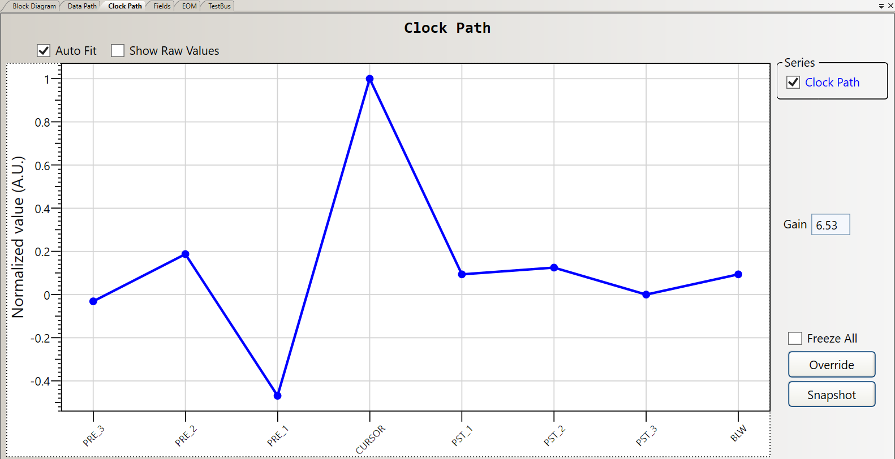
Rx Clock Path FFE
Clock path FFE key registers
rx_dtl_lms_ffe_pre3_coe_lane[3:0]
rx_dtl_lms_ffe_pre2_coe_lane[4:0]
rx_dtl_lms_ffe_pre1_coe_lane[5:0]
rx_dtl_lms_ffe_pst1_coe_lane[5:0]
rx_dtl_lms_ffe_pst2_coe_lane[4:0]
rx_dtl_lms_ffe_pst3_coe_lane[3:0]
rx_dtl_lms_blw_coe_lane[4:0]
rx_dtl_lms_gain_coe_lane[9:0]

Slide 38
Rx Clock Recovery
The timing error detector (TED) extracts phase information based on the error and the decision. It is based on a modified version of Mueller-Muller algorithm.
Low-speed TED is based on Bang-Bang phase detector. It is available for speed lower than 14G NRZ
This phase information is inserted in a second order loop filter to generate the frequency adjustment
The phase integrator accumulates the frequency adjustment of the loop filter and provide a new phase update to PI

Slide 39
Clock Recovery—Mueller-Muller vs. Edge Detector
MM detector (1X)
Single phase RX clock
Lock to data
Already on data phase
See all equalization
TX-FIR + CTLE + FFE-DTL
Requires uncorrelated random data
Edge detector (2X)
2 phases (edge+data) required
Lock on edge
Data clock 90˚ apart
See analog equalization
TX-FIR + CTLE
Requires edge transitions

Slide 40
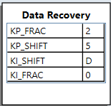
Rx Clock Path Key Registers
Loop filter bandwidth settings
rx_dtl_lpf_kp_shift_lane[3:0]
rx_dtl_lpf_kp_frac_lane[1:0]
rx_dtl_lpf_ki_shift_lane[4:0]
rx_dtl_lpf_ki_frac_lane
DTL clamping settings
rx_dtl_clamping_en_lane
dtl_clamp_rst_mode_lane[1:0]
rx_dtl_clamping_val_lane[6:0]
dtl_clamping_triggered_lane
clear_dtl_clamping_triggered_lane
Notes:
TED,

Slide 41

COMPHY_112G_ADC – RX Digital Equalization Monitors
Mean Square Error (MSE) for SNR measure
$MSE=\frac{1}{N∗P}\sum_{k=0}^{N−1}{\sum_{n=0}^{P−1}{e_{n}^{2}[k]}}$
${SNR}_{}=−10∙\log_{10}{(MSE/5)}$ (PAM4)
${SNR}_{}=−10∙\log_{10}{(MSE/9)}$ (PAM2)
Signal monitors collecting statistics of ADC output and other points in digital equalization path
Average, abs power, histogram
ADC saturation check, quality check of ADC calibrated output.
On-chip memory (OCM) to dump up to 4K consecutive samples of ADC output and other points in equalization path
ENOB estimation, proof of concept, debug purpose

Slide 43
5 nm COMPHY_112G_ADC PLL Architecture
Eugene Kim
CE AMS Team
11/29/2022

Slide 44
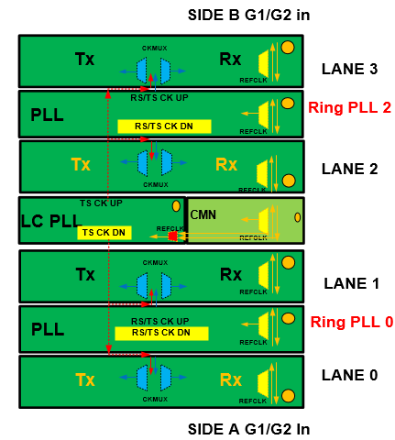
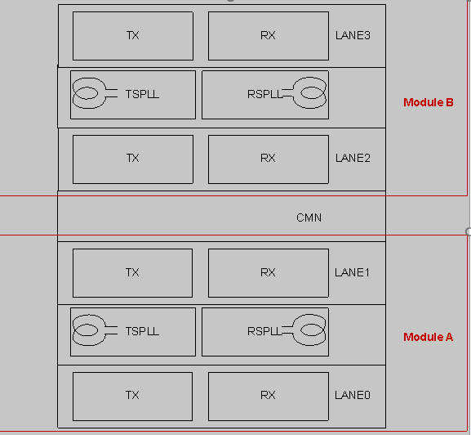
TL10 TOP
TL10 will have one LCPLL with all register prefix: PLL_CMN_***
LCPLL output cover range: >=12.5G
LCPLL is the same design as conventional 112G products
TL10 will have four Ring PLLs with all register prefix: PLL_TS_*** and PLL_RS_***
Ring PLL cover range: =<12.5G

Slide 45
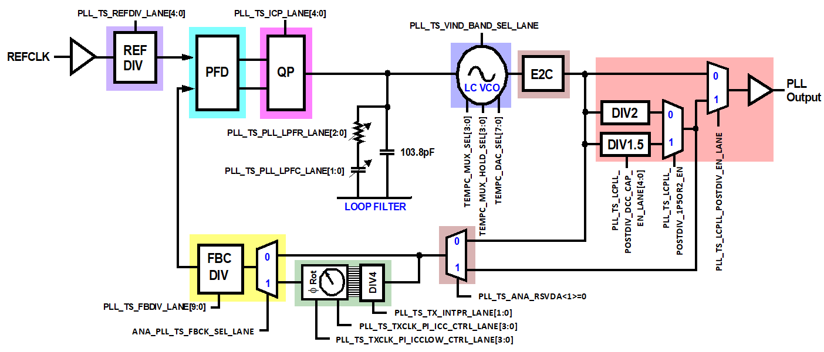
PLL Block Diagram
Please use PLL_CMN to replace PLL_TS as prefix for TL10
Notes:
TS, RS

Slide 46
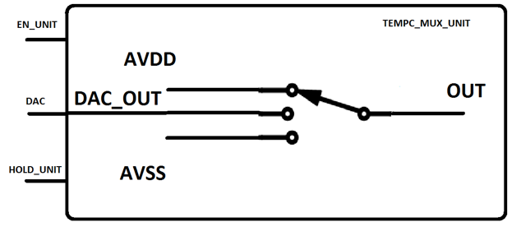
LCVCO Temperature Compensation
VCO has some temperature compensation varactors In order to optimize the performance of the PLL.
Varactors are sequentially made to move from the min to max capacitance
Temperature compensation is accomplished via 11 varactor banks to have glitchless varactor controls
Varactor must be gradually switched from being tied to AVSS to AVDD (or vice versa)

Slide 47
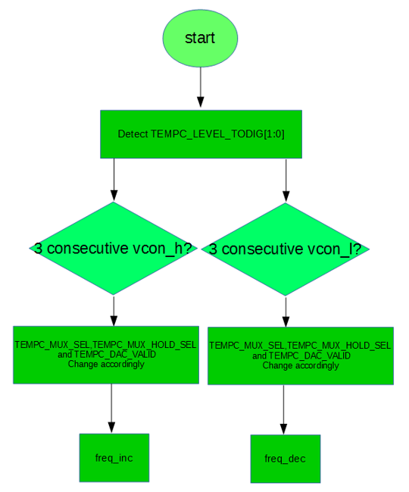
Temperature Compensation Flow
A series of 2 comparators encode 3 potential levels: vcon_h, vcon_l, and vcon_m can be read from digital logic called TEMPC_LEVEL_TODIG[1:0]’
An intervening 8-bit DAC is originally set to AVSS
DAC is slowly incremented every 40 µs
Total transition from AVSS to AVDD takes 256 × 40 µs = ~10 ms
Digital detects TEMPC_LEVEL_TODIG[1:0]’ every 5 µs (200k). The flow chart shows:
DAC code increases, the frequency increases
DAC code decreases, the frequency decreases
Notes:
TS, RS

Slide 48
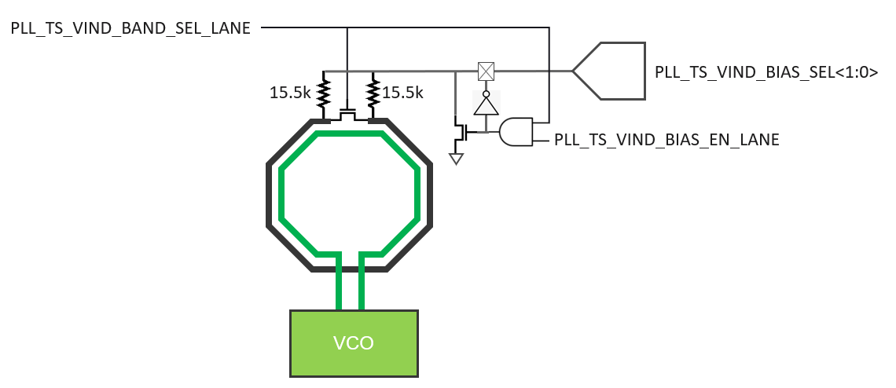
VCO Coarse Tuning
The Divide by 1.5 mode has a limitation of a maximum of 20.66 Gb/s primarily due to duty cycle and DJ concerns at higher frequencies
The PLL uses and LC-based VCO with a dual mode control on the inductor to tune the inductance slightly by introducing a parasitic loop around the primary coil
The primary coil is shown in green, and the parasitic loop is shown in black
Notes:
TS, RS

Slide 49
VCO Coarse Tuning (cont.)
The low frequency is achieved when the PLL_TS_VIND_BAND_SEL_LANE signal is low.
This signal drives the gate of the shorting NFET, so when the gate is low, the NFET is off, and the parasitic loop is not enabled
The biasing of the Source/Drain (S/D) of the switch is achieved by setting PLL_TS_VIND_BIAS_EN_LANE = 1
This turns on the NFET, pulling the S/D of the switch NFET to GND, thereby inducing a channel and completing the parasitic loop.
Notes:
TS, RS

Slide 50
PLL VCO Tuning Range
PLL VCO Frequency Ranges
VCO Range | Frequency
SLOW (Parasitic Loop OFF) | 10.8 – 15.7 GHz
FAST (Parasitic Loop ON) | 11.6 – 17.9 GHz
The default bandwidth is 1 MHz, and the range is 0.5 to 2 MHz

Slide 51
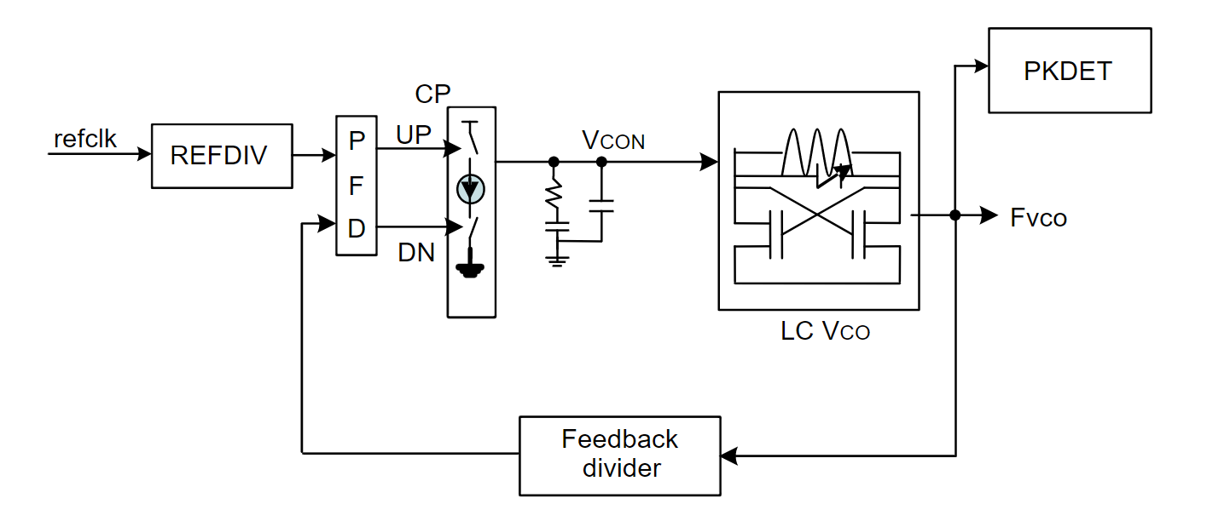
PLL Calibration
The PLL calibrations—Default bandwidth is 1 MHz, and the range is 0.5 to 2 MHz frequencies, mode amplitude, mode temperature compensation, speed-change, and duty cycle.
Power up calibration—Calibrates to target frequencies
Continuous mode amplitude calibration—The VCO output amplitude should be large enough to accommodate this calibration
Mode temperature compensation calibration—The LC PLL should be always locked over temperature
Fast start-up or speed change calibration—Fast changes the LC PLL frequency
Clock duty cycle calibration—Calibrates LC PLL output clock duty cycle to 50%
Notes:
TS, RS

Slide 52
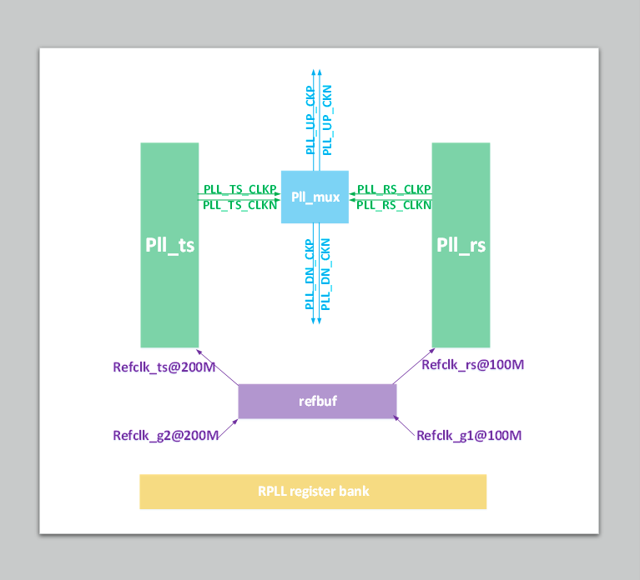
RPLL Structure 1/2
Structure
PLL
MUX
REFBUF
Loop BW
8 MHz
Lock Range
6.25 GHz to 12.5 GHz

Slide 53
RPLL Structure 2/2
Higher accuracy lock detection— Frequency counter
Low jitter—High bandwidth regulator + low jitter VCO
VDDVCO calibration

Slide 55
5 nm COMPHY_112G IBIS-AMI Model
Evelina Zhang
CE AMS Team
11/29/2022

Slide 56
IBIS-AMI Model
IBIS Algorithmic Modeling Interface (IBIS-AMI) is a modeling standard for SerDes PHYs that enables fast, accurate, statistically significant simulation of multi-gigabit serial links
IBIS-AMI models are primarily used to predict a serial link’s performance with an eye diagram and BER
In a serial link, transmitter and receiver blocks can utilize various types of equalizers including clock and data recovery circuitry
IBIS-AMI = IBIS + AMI

Slide 57
AMI Model
At high speed with the DFE and FFE, the IBIS model is no longer sufficient to represent the Tx and Rx circuits
An extension to IBIS has been developed known as IBIS-AMI (Algorithmic Modeling Interface)
The IBIS-AMI model enables fast, accurate, statistically significant simulation of multi-gigabit serial links

Slide 58
AMI Model (cont.)
In an AMI model, this can be effectively represented at the behavioral level utilizing C/C++.
Because AMI models are compiled C++ models, they cannot be reverse engineered and are, therefore, protected
Consequently, semiconductor vendors can control what details of their IP is exposed to the user, allowing them to freely distribute these models for a wide variety of EDA tools

Slide 59
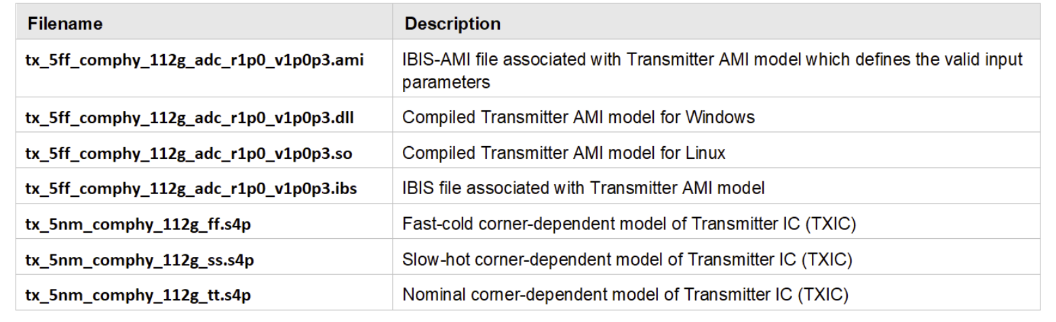
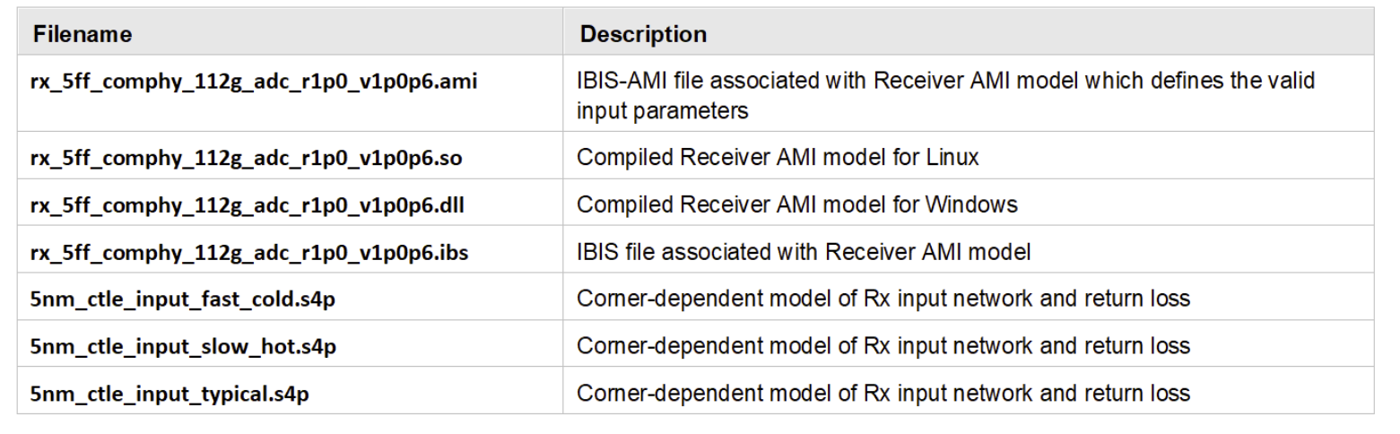
IBIS-AMI Model Files
IBIS-AMI Tx model files
IBIS-AMI Rx model files

Slide 60
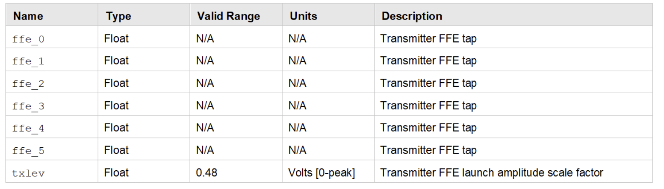
Tx AMI Model Parameters
Tx AMI model includes a 6-tap Finite Impulse Response (FIR) filter
The FIR filter is programmed by specifying the parameters:
[ffe_0, ffe_1, ffe_2, ffe_3, ffe_4, ffe_5] = [furthest_pre_cursor, …, furthest_post_cursor]

Slide 61
Tx AMI Model Parameters (cont.)
The position of the cursor-tap is configurable and can either be at the ffe_3 position or the ffe_4 position
Each coefficient is a dimensionless floating-point value
The coefficients can take on any value, but the following hardware constraint is strictly enforced within the AMI model:
∑|𝑓𝑓𝑒𝑘| ≤1.05𝑘=0
If the user specifies a set of coefficient values that would cause this constraint to be exceeded, a scale factor is applied uniformly to all coefficients such that:
∑|𝑓𝑓𝑒𝑘|=1.05𝑘=0

Slide 62
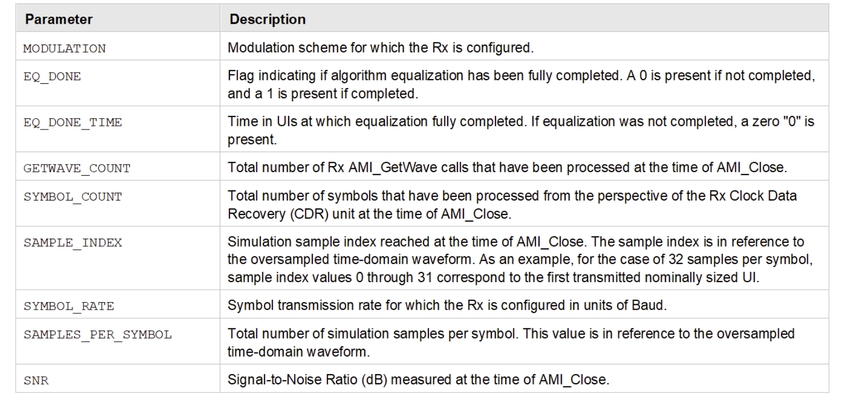
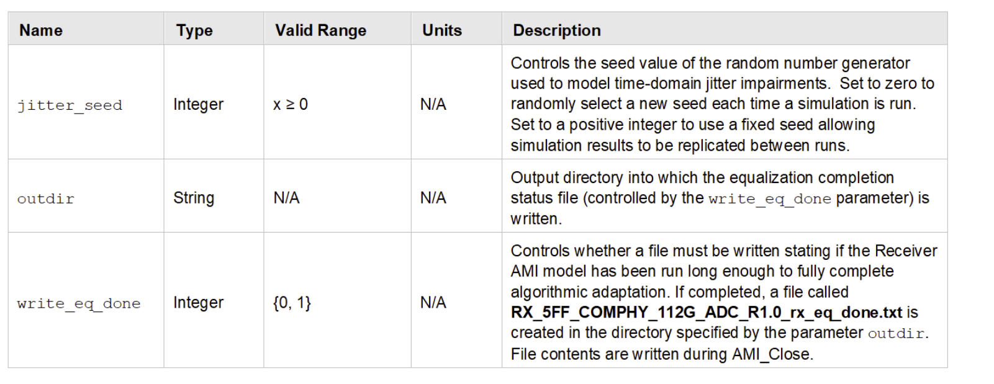
Rx AMI Model Parameters
The primary reserved and model-specific parameters of the Rx IBIS-AMI model are:
Contents of the generated file RX_5FF_COMPHY_112G_ADC_R1.0_ rx_eq_done.txt

Slide 63
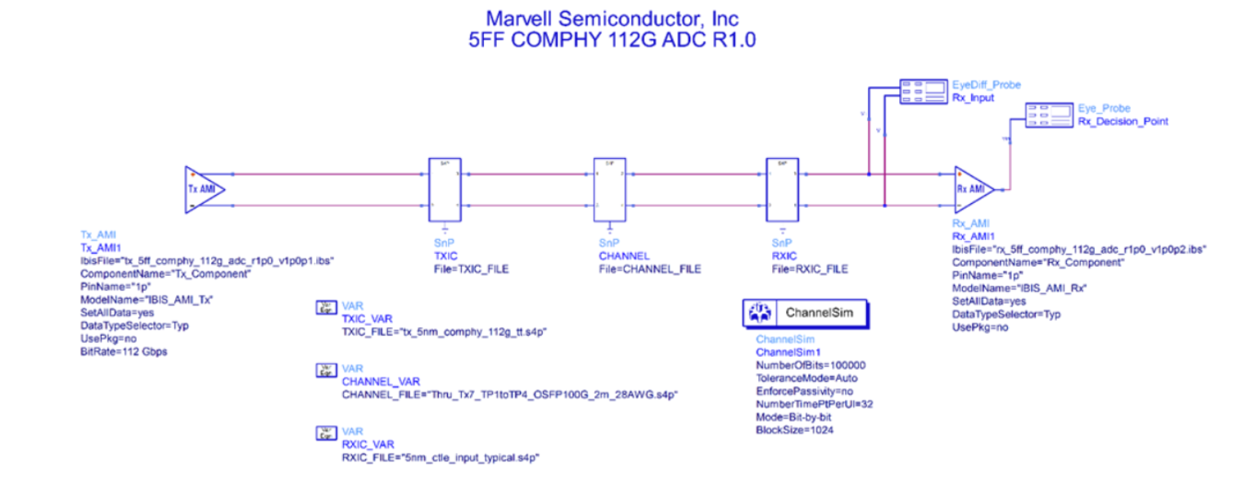
IBIS-AMI Model Simulation Setup

Slide 64
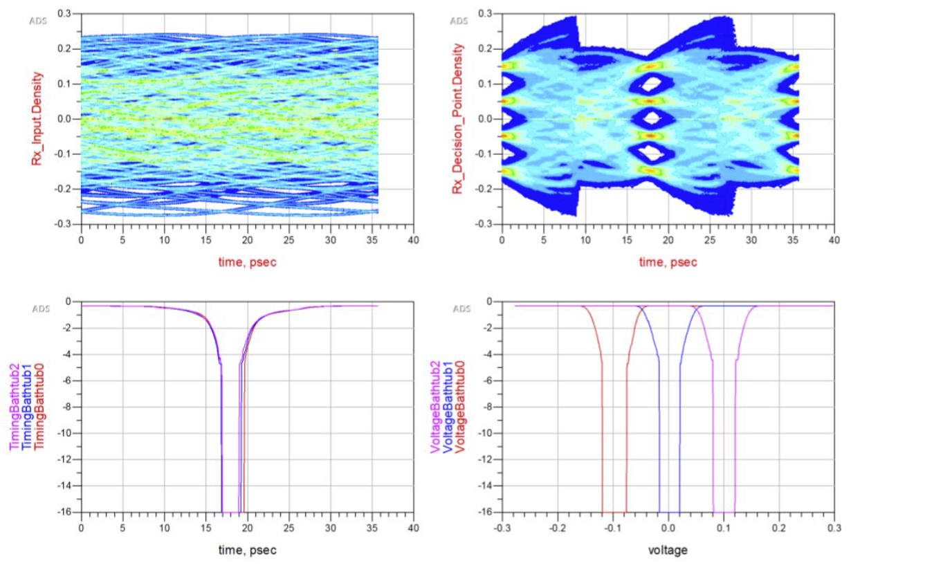
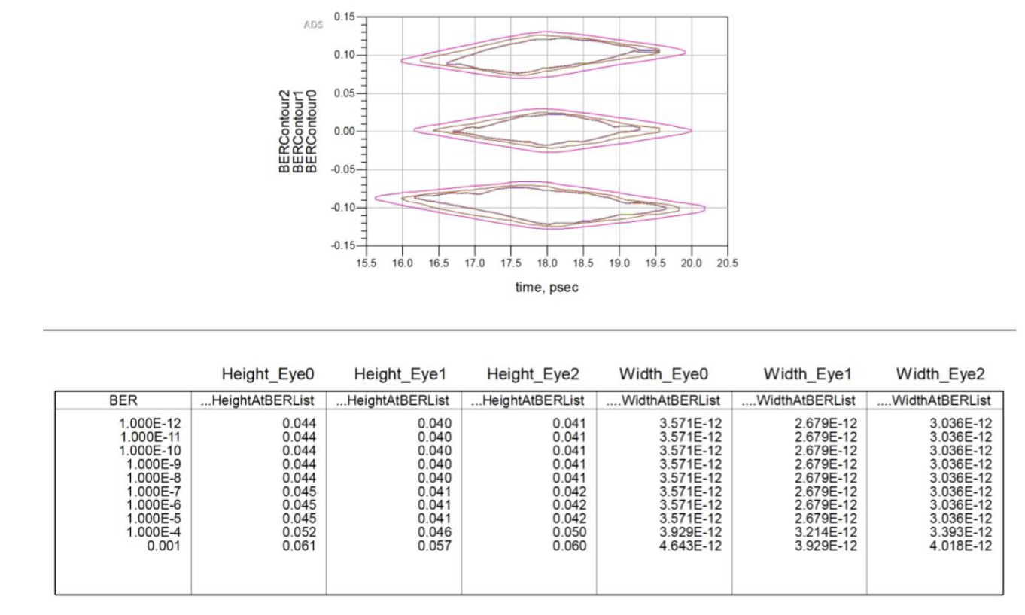
Rx AMI Model Simulation Result

Slide 65
Rx AMI Model Correlation Report
Tx Correlation report
Test Measurement Set Up
Model files path
Tx correlation result (corners with revision update) Tx amplitude
Waveforms collected
Setting of models
Model simulation waveform results
Tx FIR (c0-c5)
Measurement results collected
Setting of models
Model simulation results
Summary
Rx Correlation report
Test Measurement Set Up
Model files path and design parameters
Rx correlation result (corners with revision update) Test conditions:
Digital Rx figures of merit
Pass/fall EO criteria
Correlation results (NRZ, PAM4)
TT corner graphic EO results
Summary

Slide 66
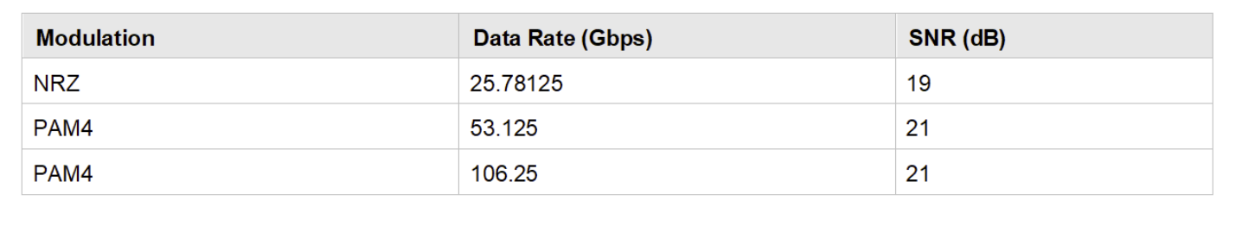
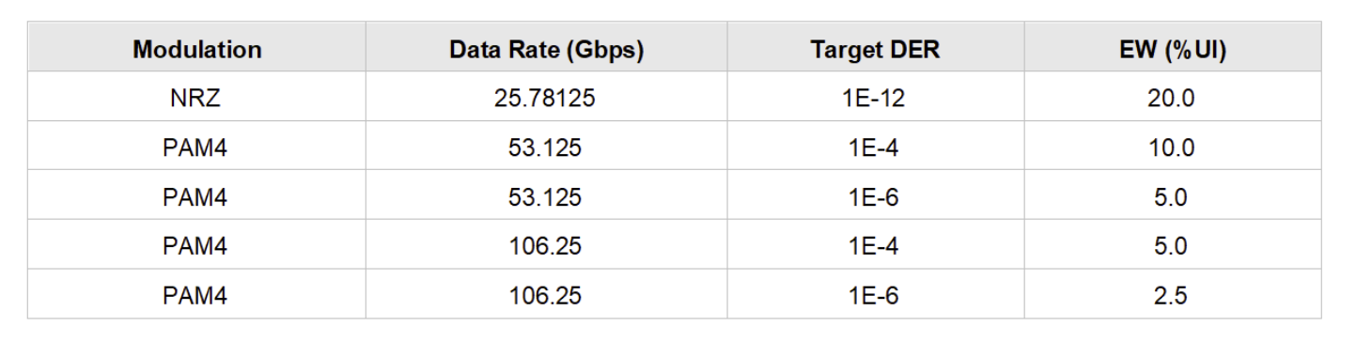
Rx AMI EO Pass/Fail Criteria
Minimum SNR criteria
Minimum eye width criteria

Slide 67
Rx AMI EO Pass/Fail Criteria
After simulation, the Rx model writes the steady-state SNR value to the file: RX_5FF_COMPHY_112G_ADC_R1.0_rx_eq_done.txt
If Keysight ADS is used, this file is written by default to the ./data directory of the current workspace
Another location can be specified by modifying the out-dir parameter from the ADS user interface

Slide 68
Document and Support
Application document served as user guidance:
COMPHY_112G_IBIS-AMI_Model_App_Note_5FF ( bundled with model)
Correlation document for both Tx and Rx
COMPHY_112G_IBIS-AMI_Rx_Model_Correlation_Report_5FF http://ipdoc.marvell.com/ceips/ReadSharepointFile.php?href=https://sp.marvell.com/central/hsio/Projects/PHY_IPs/IBIS_AMI_MODEL/COMPHY/5nm/112G/Doc/COMPHY_112G_IBIS-AMI_Rx_Model_Correlation_Report_5FF.pdf
COMPHY_112G_IBIS-AMI_Tx_Model_Correlation_Report_5FF http://ipdoc.marvell.com/ceips/ReadSharepointFile.php?href=https://sp.marvell.com/central/hsio/Projects/PHY_IPs/IBIS_AMI_MODEL/COMPHY/5nm/112G/Doc/COMPHY_112G_IBIS-AMI_Tx_Model_Correlation_Report_5FF.pdf

Slide 70
Time | Topic | Presenter
8:00 – 8:10 | Short introduction | All
8:10 – 08:40 | Architecture - TX | Dino Wang
8:40 – 8:55 | Architecture - TX Q&A section
8:55 – 09:10 | Break
09:10 – 09:30 | Architecture – Digital Function | Remby Taas
09:30 – 09:45 | Architecture – Digital Function Q&A section
09:45 – 11:00 | Break
11:00 – 11:30 | Architecture - DSP | Hongjie Qian
11:30 - 11:45 | Architecture - DSP Q&A section
11:45 –12:00 | Lunch
AGENDA

Slide 71
Legal Statement:
CONFIDENTIAL INFORMATION
The information contained in this presentation is the confidential and proprietary information of Marvell. You are not permitted to disseminate or use any of the information provided to you in this presentation outside of Marvell.
This material MUST NOT be distributed to customers

Slide 72
5 nm COMPHY_112G_ADC Tx Architecture
Dino Wang
CE AMS Team
11/30/2022

Slide 73
Outline
Tx Function Architecture Overview
Tx Function Validation Tests
Tx FIR/Emphasis
Tx Amplitude
Tx Calibration
Tx DCC/Align90 Calibration
Tx Impedance Calibration
Tx VDDR Calibration
Tx Jitter/Eye diagram

Slide 74
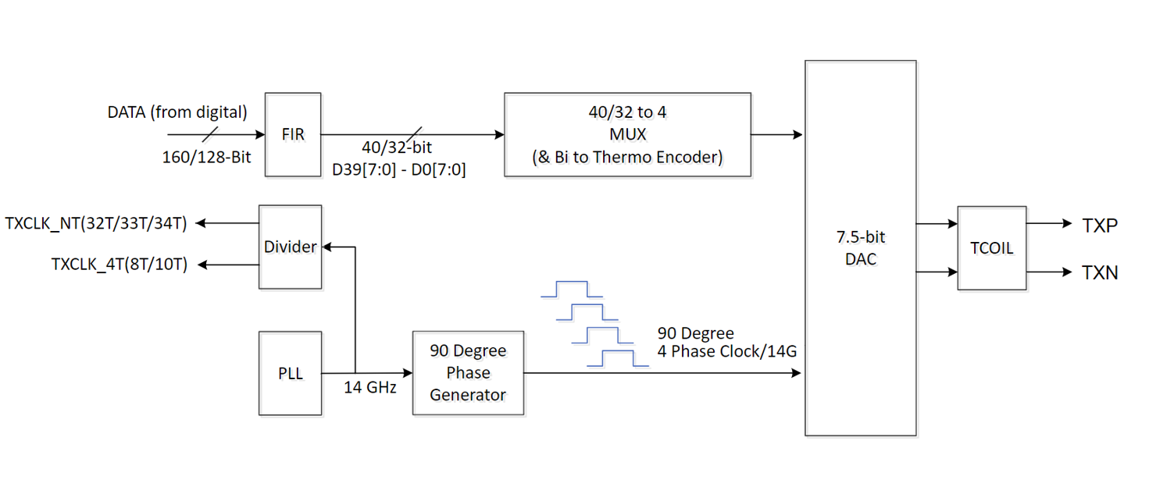
COMPHY_112G_ADC—Tx Function
Quarter rate architecture
6-Tap Tx FIR with main tap programmability
SST driver with good linearity and low power
Calibrations for PVT variation
Regulators for high-speed clock path
Low voltage and low power design
Beacon, LFPS, Scan Bypass

Slide 75
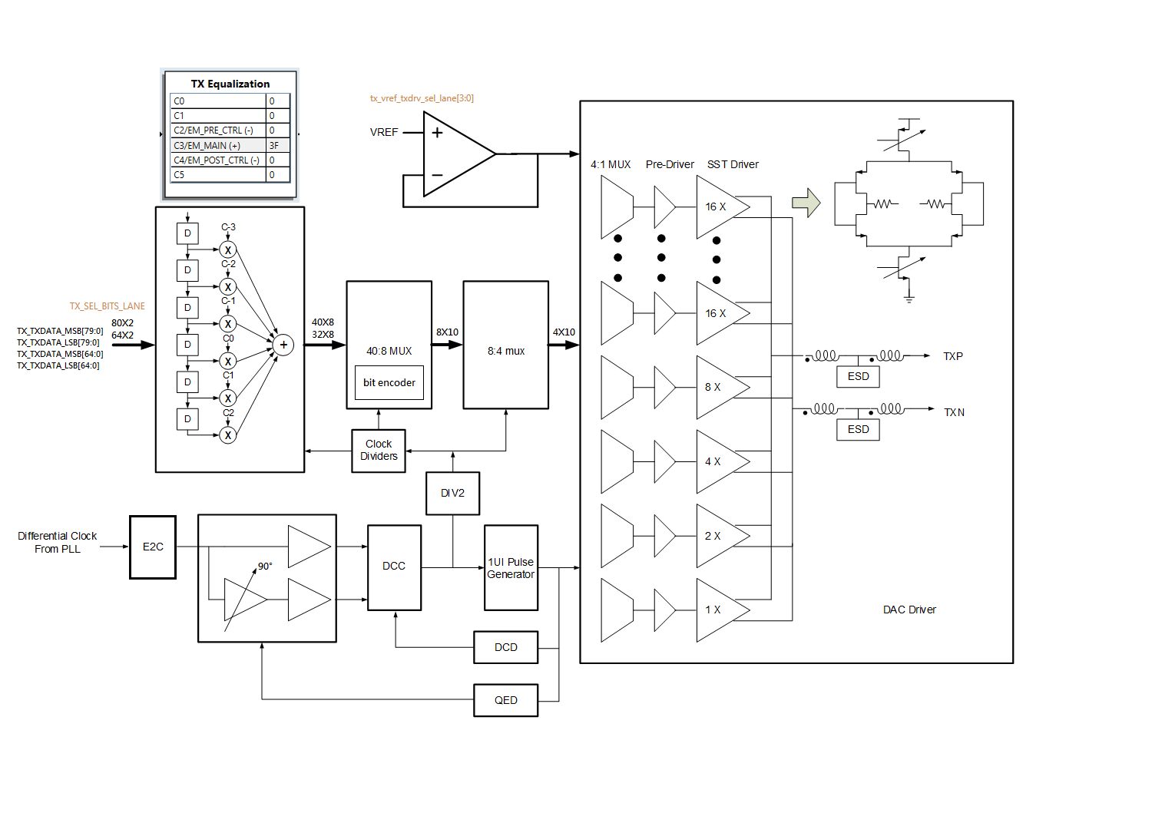
COMPHY_112G_ADC—Tx Function

Slide 76





Tx FIR
The Tx FIR has up to 6 taps with 3 pre-taps and 2 post-taps
Tx FIR resolution is from 0 to 63, the step size is 1.59%

Slide 77


Tx FIR/Emphasis
Tx main tap = 58
Tx main tap = 58; Tx post1 tap = -5 (de-emphasis)

Slide 78


Tx FIR/Emphasis
Tx main tap = 58; Tx pre1 tap = -5 (pre-shoot)

Slide 79




Tx Amplitude
106G PAM4 2T Clock Pattern

Slide 80


Tx Amplitude
106G PAM4 40T Long Pattern

Slide 81

Tx Calibration
TX DCC/Align90 Calibration
Clock duty cycle with E2C calibration — Duty cycle of the common clock from PLL is calibrated to be 50%
Clock 90-degree alignment calibration (cont.) — Calibrates each phase through 90° delay control to generate evenly spaced phases
Non-delay path clock duty cycle calibration (cont.) — Duty cycle of non-delay path clock after phase generation is calibrated to be 50%
90-degree delay path clock duty cycle calibration (cont.) — Duty cycle of 90° delay path clock after phase generation is calibrated to 50%
Clock duty cycle with post divider calibration (cont.) — Post divider is enabled, duty cycle of the divided-down clock is calibrated to be 50%

Slide 82


Tx Calibration
TX Impedance Calibration
Tx impedance calibration — Calibrates Tx output impedance to be 50Ω
Tx impedance temperature compensation (cont.) — DAC output would change applied voltage on P/NMOS over temperature change

Slide 83



Tx Calibration
VDDR calibration for clock path and data path
trx_vddr_txdata_cal_result_ext_lane[4:0]
trx_vddr_txdata_cal_result_rd_lane[4:0]
trx_vddr_txclk_cal_result_ext_lane[4:0]
trx_vddr_txclk_cal_result_rd_lane[4:0]

Slide 84


Tx Jitter/Eye Diagram
Tx Jitter
EOJ (Even-Odd Jitter), J3u, Jrms
Compliance test —100G/50G KR, CR, C2M

Slide 85

Tx Eye Diagram

Slide 87
5 nm 112G COMPHY Function
Remby Tass
CE AMS Team
11/30/2022

Slide 88
COMPHY_112G_ADC PHY Functions
Power control sequence
PHY initialization
Rx initialization
Speed change
Soft reset
Squelch detection
Isolation mode
Loopback mode
PHY test
ACJTAG test
Scan bypass
Burn in test
PHY latency
TX latency
RX latency
Eye Opening Mode (EOM)

Slide 89
Power Control Sequence
PHY power control sequences include power up/down, speed change, soft reset, and more
SoC controls power control PINs
PIN_PU*, PIN_RESET_CORE*, and more
PHY MCU handles the power sequence and interact with analog circuit
Example of power up sequence
Asserting ANA_PU* after PIN_PU* assertion
Load speed table
Trigger calibrations (PLL calibration)
Asserting PIN_PLL_READY after calibration is done

Slide 90


Initialization
PHY Initial Power-on Sequence Timing
This IP requires all lanes to be power on during the initial power-on sequence, that is, PIN_PU_PLL, PIN_PU_TX and PIN_PU_RX of 4 lanes must be high during the initial power on
The power-on sequence initiates automatically whenever PIN_RESET transitions from 0x1 to 0x0 and PIN_PU_PLL is 0x0
During the power-on sequence, and before the internal PLL of the PHY is ready, the REFCLK outputs on PIN_TXDCLK and PIN_RXDCLK

Slide 91


Rx Initialization
Rx initialization is performed with pins PIN_RX_INIT, PIN_RX_INIT_DONE, and PIN_RXP, PIN_RXN
45

Slide 92


Speed Change Sequence
44

Slide 93
Speed Change
Data rate can be changed by configuring PIN_PHY_GEN_RX and PIN_PHY_GEN_TX
Set PIN_TXDATA_GRAY_CODE_EN, PIN_TXDATA_PRE_CODE_EN, PIN_RXDATA_GRAY_CODE_EN, and PIN_RXDATA_PRE_CODE_EN based on the pre/gray coding requirement before changing PIN_PHY_GEN_RX and PIN_PHY_GEN_TX
The pins PIN_PLL_READY_TX and PIN_PLL_READY_RX de-assert and then re-assert
43

Slide 94
Speed Change (cont.)
When valid data appears on Rx, the SoC asserts PIN_RX_INIT to initialize the receiver as directed
The same is true in Wake Up from Slumber mode
The REFCLK on PIN_TXDCLK and PIN_RXDCLK can be disabled by setting PHY register REFCLK_ON_DCLK_DIS_LANE = 0x1
43

Slide 95


Soft Reset
87

Slide 96
Soft Reset
The soft reset is performed by PIN_RESET_CORE_TX and PIN_RESET_CORE_RX and the status is reflected by PIN_RESET_CORE_ACK_TX and PIN_RESET_CORE_ACK_RX
Unlike normal slumber/wakeup and speed change sequences which do not allow any PHY configuration change, soft reset grants the higher layer the flexibility to change the pin configurations, reference clock sources, and the register programming values for the upcoming data transfer after the reset release
87

Slide 97

Squelch Detection

Slide 98


Squelch Detection
Squelch detection detects PIN_RXP/PIN_RXN
When PIN_RXP/PIN_RXN changes from z to 0/1, sq_out changes from 1 to 0 after 100 ns
When PIN_RXP/PIN_RXN changes from 0/1 to z, sq_out changes from 0 to 1 after 100 ns

Slide 99

Squelch Detection For Long 1/0
AC coupling mode, if PHY PIN_RXP/PIN_RXN receive no toggling 1/0 for 10 µs, the PIN_SQ_DETECTED becomes 0x1 and PIN_SQ_DETECTED_LPF becomes 0x1 after the filter time
The filter time is configurable (10 ns to 10 ms) by register SQ_LPF_LANE[15:0]

Slide 100
Squelch Detection
SQ glitch filter enabled by register SQ_DEGLITCH_EN_LANE
Glitch width is set by register SQ_DEGLITCH_WIDTH_P_LANE, SQ_DEGLITCH_WIDTH_N_LANE
RXP
z
z
RXN
z
z
z
SQ
glitch
glitch
sq_out_deglitch
latency

Slide 101

Digital Squelch Detection
At higher data rates/long channels, distinguishing signal or noise detection for SQ is difficult
Digital SQ detection circuit for more robust estimator of signal energy presence from ADC
Digital SQ detector approximates envelope peak detection
ADC sample compare against peak amplitude estimate
Increment (with 32)/decrement (with 1) accumulator according ADC sample comparison to peak amplitude estimate
Tracks the outer envelope of signal rather than average
Accumulated envelope amplitude compared against threshold for SQ detection

Slide 102
Isolation Mode
The PHY isolation mode is used to isolate the PHY from SoC control
In this mode, most of the PHY pins are invalid
Certain PHY registers are used to replace the corresponding pins
Only the analog, power supply, DFT and register access pins are valid
This mode is commonly used for debug purpose, which confirms the issue is inside or outside the PHY
This mode is enabled by programming the register PHY_ISOLATE_MODE to 1

Slide 103

Isolation Mode Pins

Slide 104

Loopback
This PHY supports the following loopback mode tests:
Far-end loopback mode
Local digital parallel loopback mode
Local analog serial loopback mode
External loopback mode

Slide 105
Loopback Control
Far-end loopback mode
The far-end PHY sends the test pattern through its Tx pads
The local PHY receives the test pattern at its Rx pads and forwards the received test pattern from Rx to Tx
The local PHY then sends the test pattern back to the far-end PHY through its Tx pads

Slide 106
Loopback Control
Local analog serial loopback mode
The PHY sends the locally generated test pattern to the internal node of CTLE
The data is looped back to the analog Rx portion of the internal PHY
The test controller checks the received data and sets the test pass or fail flag accordingly
Register set: LOCAL_ANA_TX2RX_LPBK_EN_LANE

Slide 107
Loopback Control
External loopback mode
The PHY sends a test pattern to Tx
The test pattern exits the PHY Tx pads through the AC coupling cable and back to the PHY Rx pads
The test controller checks the received data and sets the test pass or fail flag accordingly
This feature is ideal for ATE tests
No need to set registers

Slide 108
Loopback Control
Local digital parallel loopback mode (SoC bypass the PHY)
The SoC sends the data on the input PIN TXDATA directly to PIN_RXDATA, bypassing all internal logic of the PHY
This mode is only a method to loop the data that has its actual origin at the SoC level
Register set: LOCAL_DIG_TX2RX_LPBK_EN_LANE

Slide 109

PHY Test
The PHY test function tests the PHY by using pre-defined test patterns This function contains the following modules:
Pattern generation and transmission module
Pattern reception and comparison module

Slide 110

PHY Test Pattern Selection
78

Slide 111



ACJTAG Test
Rx ACJTAG detects/recovers low frequency beacon/AC-JTAG signals in AC-coupled connection
Used to detect connection faults on TX and RX differential pins
COMPHY must reset before performing this task or else analog registers will not toggle

Slide 112
ACJTAG Test Steps
After PIN_RESET is released, set the PINs to the expected value
Send patterns (maximum 100 MHz) through PINs listed below:
PIN Name | Value
PIN_RX_ACJTAG_AC0 | 1'b1
PIN_RX_ACJTAG_EN0 | 1'b1
PIN_RX_ACJTAG_HYST0 | 3'b010
PIN_RX_ACJTAG_DCBIAS0 | 3'b010
PIN_RX_ACJTAG_MODE0 | 1'b1
PIN_TX_ACJTAG_EN0 | 1'b1
PIN_RX_ACJTAG_INITN0 | 1'b0
PIN_RX_ACJTAG_INITP0 | 1'b0
Input PINs | Output PINs
PIN_RXP0 | PIN_RX_ACJTAG_RXP0
PIN_RXN0 | PIN_RX_ACJTAG_RXN0
PIN_TX_ACJTAG_IN0 | PIN_TXP0
 | PIN_TXN0 (Reversed PIN_TXP0)

Slide 113

Scan Bypass
Send/receive scan test patterns bypass the COMPHY through Tx/Rx pins

Slide 114
Scan Bypass (cont.)
Connect PIN_SCN_CLK and all the PIN_AS_SCN_CLK* to 100 MHz (maximum frequency) clock
After PIN_RESET is released, set:
SoC can send patterns through the PINs listed below while performing scan test through *SI* and *SO* PINs
PIN Name | Value
PIN_SCNTEST | 1’b1
PIN_SCN | 1’b1
PIN_SCN_ISO | 1’b1
Input | Output
PIN_SCN_TXP_DIN0 | PIN_TXP0
PIN_SCN_TXN_DIN0 | PIN_TXN0
PIN_RXP0 | PIN_SCN_RXP_DOUT0
PIN_RXN0 | PIN_SCN_RXN_DOUT0

Slide 115
Burn-in Test
Can perform MBIST at the same time
Analog sends out PRBS pattern on PIN_TXN/P and receives pattern from PIN_RXN/P
Analog regulator voltage raised by 20% through analog internal control
Analog registers have no clock and will not toggle

Slide 116
Burn-in Test (cont.)
Digital circuit is isolated from analog circuit during analog burn-in mode
COMPHY must reset before performing this task
Steps:
After PIN_RESET is released, send reference clock
Set PIN_BURN_IN_TEST to 1

Slide 117




Tx Latency
Tx data latency—Measured as the time required for the first parallel data bit to appear on the serial bus
Tx idle latency—When PIN_TX_IDLE = 0x1, PIN_TXP and PIN_TXN are in the idle state

Slide 118


Rx Latency
Rx data latency—Measured as the time between the last data bit on the serial bus to the parallel data clock

Slide 119

Repeater Mode
Repeater mode according to Ethernet standard
Tx data of host PHY aligned to Rx data of line PHY
Frequency of Tx of host PHY follows the frequency of Rx line PHY
May have ±100 ppm frequency offset to the refclk

Slide 120



EOM (Eye Open Measure)
Non-destructive RX Internal eye plot, eye height, eye width
Additional HW to process digital slicer input at different slicer position than main ADC current slicer position
PAM4 : Top eye, Middle Eye, Bottom Eye
PAM2/NRZ : Middle Eye only

Slide 121
EOM Structure
Separate EOM ADC
Channel estimator calculates channel impulse response
Reconstruction filter calculates slicer input at Δτ phase

Slide 123
5 nm 112G COMPHY DSP Training
Hongjie Qian
CE AMS Team
11/30/2022

Slide 124
TRx Training Outline
1 | Overview
 | Scope and Metrics
2 | Training Flow
 | Top Level Training Stages/States
3 | Rx Training
 | Analog—Continuous Time Linear Equalizer (CTLE) Training Digital Equalization Control—Clock and Data Recovery (CDR)
4 | Tx Training
 | Tx Feed Forward Equalizer (Tx-FFE) Preset and Shape Training
5 | Troubleshooting

Slide 125
Protocol Support
Supported training protocol:
IEEE 802.3ck – PAM4 100G/lane
IEEE 802.3cd – PAM4 50G/lane
IEEE 802.3bj – NRZ 25G/lane
IEEE 802.3ap – NRZ 10G/lane
Link Training (LT) features:
Covers IEEE 802.3 clause 72 (10G/25G), 136 (50G), and 162 (100G)
SoC handle speed Auto-Negotiation (AN) and IP handles LT

Slide 126

Overview
After startup at the link speed, the Rx applies equalization and determines the quality of the signal before transitioning to data traffic
Start
Training
Data traffic
SoC Triggered
Return to SoC

Slide 127
Training Scope
Training space
Tx-equalization
Rx-Analog Front End (AFE) equalization-CTLE
Rx-digital equalization – FEE, DFE
Rx quantifies the quality of the signal by multiple Figure of Merits (FOM)
Analog Front End
Rx Digital Parallel Processing
TX
CTLE
ADC
FFE
DFE
to slicer
etc.
channel

Slide 128
Training Metrics
Figure of Merits (FOM)
ADC Dynamic Range (ADC-DR)-- does not require recovered clock
Frequency content of ADC samples -- does not require recovered clock
Digital equalization shapes -- require recovered clock and/or recovered data
Signal to Noise Ratio (SNR) -- requires recovered clock and/or recovered data
FOM(s) are measured using hardware monitors and fed to the integrated microcontroller (MCU)

Slide 129




Training Metrics ADC-DR
Target ADC-DR—Defined by ADC threshold
ADC output (input of FFE) range = -64 to +63
Saturation measured by sample count beyond target DR (CDF)
Analog Front End
Rx Digital Parallel Processing
CTLE
ADC
FFE
DFE
rx_in
dcs
slicer

Slide 130

Training Metrics Frequency Content of ADC
Equalization as measured by frequency content
Analog Front End
Rx Digital Parallel Processing
CTLE
ADC
FFE
DFE
rx_in
dcs
slicer

Slide 131





Training Metrics SNR and Equalizer Shape
Performance optimization after clock recovery (and/or data recovery) based on SNR and digital equalizer shape
SNR
Analog Front End
Rx Digital Parallel Processing
$${Slicer input (s}_{in})$$
+3
$$snr=func(err)$$
CTLE
ADC
FFE
DFE
+1
$$err=dcs−s_{in}$$
rx_in
-1
slicer
-3
$$dcs=\{−3, −1, +1, +3\}$$
Digital Equalizer

Slide 132
FOM Monitors
Training algorithm control the monitors and observe FOMs from MCU
Rx Digital Parallel Processing
select
Monitor
Analog Front End
TX
channel
CTLE
ADC
FFE
to slicer
etc.
LMS-FSM
Via remote request
MCU for training algorithm, adaptation control etc.

Slide 133
Training Flow
FW training controls the training algorithms and state-machine
Tx-training has additional steps
Standard dictates the modulation types and presets for Tx-training

Slide 134
CTLE Training
2 steps:
Required param tuning
Optional param tuning
Setting initial CTLE necessarily does not change the trained CTLE values, rather speed up the training
Decision to tune optional CTLE param is based on saturation or ADC-DR usage
Optional CTLE tuning is only required for very extreme channels (very short or very long)

Slide 135



CTLE Parameters—R, C, GC
Examples at 100G
Analog control are mapped to training control for simplification and ease of use
Training controls
DC gain: R
Peak gain: C
Broadband gain: GC
Boost = Peak - DC
R
C
Param Increase | DC Gain | Peak Gain | Boost
R
C
GC
GC

Slide 136



CTLE Training—R, C, GC vs FOMs
ADC-DR impacted by R, C, GC
LP more impacted by R (DC-Gain)
HP more impacted by C (Peak-Gain)
GC (broad-band gain) has similar impact on LP and HP
Saturation count shown in pic, as a % div by total count = 2¹⁶

Slide 137
CTLE Training—R, C, GC
R, C, and GC training
Does not require recovered clock
Find the (R, C) which provides good equalization
Find the (R, C, GC) which minimizes saturation and maximizes ADC-DR usage

Slide 138


Optional CTLE Parameters
Optional training controls—Attenuation
Examples at 100G
Param Increase | DC Gain | Peak Gain | Boost
A
A
A
Saturation count shown in pic, as a % div by total count = 2¹⁶

Slide 139
Optional CTLE Param Training—Attenuation
Additional CTLE param training
Only applicable in very short or very long channels
Does not require recovered clock
Find attenuation which minimizes saturation and maximizes ADC-DR usage
Adjustment of R, C, GC necessary

Slide 140
CTLE Training—Troubleshooting
Is ADC-saturated? Or well below target DR?
OCM from API/Raptor2 GUI
Test Point (TP): ADC saturation measure
The following registers should be at a low value (order of 10s; not 100s)
rx_train_adc_in_sat_60_at_train_end_lane[15:0] – 94% (60/64) ADC-DR
rx_train_adc_in_sat_56_at_train_end_lane[15:0] – 87% (56/64) ADC-DR

Slide 141
CTLE Training—Troubleshooting
Troubleshooting
CTLE controls
For a longer channel expect higher gain and boost (higher C, higher GC)
For shorter channel expect lower gain and boost (lower C, lower GC)
R usually higher unless very large Tx-FIR pre-emphasis

Slide 142
CTLE Training—Troubleshooting
Test points
The range quoted here are absolute maximum, and depends on speeds and other CTLE controls
Training usually operate on different ranges depending on speed
CTLE attenuation is expected to be 0 (default) for most channels
Param | Functions | Range (Code) | Range (in dB) at 100Gbps | Comment
rx_train_ctle_C_lane[7:0] | CTLE peaking control | [0, 45/64] | 13 dB at peak [0, 45] at 100G | Finer control, Higher resolution
rx_train_ctle_GC_lane[4:0] | CTLE Broadband gain control | [0, 15] | 11 dB at nyq | Coarser control
rx_train_ctle_R_lane[4:0] | CTLE DC gain control | [0, 15] | 22 dB at DC | Coarser control
rx_train_ctle_atten_lane[7:0] | CTLE attenuation control | [-21, 20] | 11 dB at nyq [-9 to 18] at 100G | Coarser control

Slide 143
Clock and Data Recovery (CDR)
Hardware loops, training only controls
Enables
Related parameters
Important for troubleshooting
Clock recovery achieved with a dedicated digital path performing a local data recovery and timing error estimation—clock path/digital timing loop
Data recovery is achieved with a dedicated digital path with recovered clock from clock recovery—data path
Data-path equipped with longer FFE and an DFE

Slide 144
Clock Recovery
In higher speed, Rx clock recovery is done by a Mueller-Muller detector which feeds a second order loop driving the Rx clock generation
Training controls the enables and related parameters of different loops
Training controls the LMS engine of DTL-FFE
Parameter | Spec
FFE pre-cursor # | 3
FFE post-cursor # | 3

Slide 145
Data Recovery
Training controls the enables and related parameters of different loops
Training controls the LMS engine of DP-FFE, DFE
FW-based training optimize
Position of floating banks
Number of active taps
Parameter | Spec
FFE pre-cursor # | 6
FFE (fixed) post-cursor # | 16
FFE floating # | 2 banks of 4 taps up to 120 UI
DFE # | 1

Slide 146
CDR Troubleshooting
DTL Clamping—Frequency offset exceeded pre-defined range (±500 ppm)
dtl_clamping_triggered_lane
Frequency offset should not be very large
From Raptor2 GUI
From registers
Toggle rx_dtl_fofst_req_lane
Read rx_dtl_fofst_stable_lane[31:0]—In ppm: rx_dtl_fofst_stable_lane[31:0] x 1e6 /2^41.0

Slide 147
CDR Troubleshooting (cont.)
Tp-SNR (divide by 2^5, add +7 for PAM4, +9 PAM2 to get SNR in dB)
Clock path
trx_tp_snr_dtl_bf_train_end_lane[15:0]
trx_tp_snr_dtl_af_train_end_lane[15:0]
Data path
trx_tp_snr_dp_bf_train_end_lane[15:0]
trx_tp_snr_dp_af_train_end_lane[15:0]
During mission mode—[read SNR in (mil) dB]
Read SNR via API
Read SNR via Raptor2 GUI

Slide 148
CDR Troubleshooting (cont.)
Digital equalizer shape
No hard and fast rules
— Is there any saturated taps?
Registers —Toggle rx_eq_rd_req_lane to read
For CP/DTL
For filter coefficents – read rx_dtl_lms_ffe_*_coe_lane[x:0]
For gain – read rx_dtl_lms_gain_coe_lane[9:0]
For blw – read rx_dtl_lms_blw_coe_lane[4:0]
For DP
For filter coefficents – rx_dp_lms_ffe_*_coe_lane[x:0], rx_dp_lms_dfe_coe_lane[5:0]
For gain – read rx_dp_lms_gain_coe_lane[10:0]
For blw – read rx_dp_lms_blw_coe_lane[5:0]
How to tell a tap is saturated
Filter coefficients are signed
For bit-width of X → tap range -2^(X-1) to +2^(X-1)-1
DTL example: rx_dtl_lms_ffe_pre1_coe_lane[5:0]
Bit-width = 6 bit; range = -32 to 31
DP example: rx_dp_lms_ffe_pre1_coe_lane[6:0]
Bit-width = 7 bit; range = -64 to 63

Slide 149
Tx Training Algorithm
Algorithm flow implemented in FW
Tx training HW interface is initiated and used to ask for modulation, preset, and coefficient updates
In most channels, in ADC-based SerDes, performance dependence on Tx FIR shape will be much lower due to available pre-cursor in Rx FFE

Slide 150
Tx Training Preset Request
Initial preset-request is done by checking ADC frequency content
Preset change may unlock CDR
Change in preset requires changes in CTLE (and relock if necessary)
External preset forcing available
Set trx_train_txffe_preset_ext_en_lane = 1
Set trx_train_txffe_preset_ext_lane[2:0]
Tx-FIR with no pre-emphasis can cover most channels

Slide 151
Tx Training Optional Tx FIR Tune
Rx-digital equalization shape and/or SNR considered when requesting remote Tx-FIR coefficient update
Care taken to change remote Tx-FIR gradually and not to unlock CDR

Slide 152
Training Troubleshooting
Previously discussed
CTLE troubleshooting
CDR troubleshooting
Calibration
ADC Calibration–gain and offset–should be close to center (within 10 code of 0 for most channels)
Available in Raptor2 GUI
Registers
Toggle rx_adc_if_rd_req_lane
For gain cal - read rx_adc_if_gain_word*_lane[5:0] → only +ve
For offset cal - read rx_adc_if_ofst_word*_lane[6:0] → can be +ve and –ve
Skew-calibration should be within reasonable value around center code (138), and should not be close to max (=255) or min (=0)
Available in Raptor2 GUI
Registers
Toggle rx_skew_rd_req_lane
Read skew_adapt*_lane[8:0]

Slide 153
Training Troubleshooting (cont.)
Signal detection/Squelch
PIN_RX_SQ_OUT_LPF_RD_LANE = 1 indicates no signal
train_abort_reason_lane[1:0] = 3 indicated training aborted due to no-input/squelch
Timeout (important for Tx training)
TRX_TRAIN_TIMEOUT_LANE = 1 indicates timeout was triggered
train_abort_reason_lane[1:0] = 1 indicated training aborted due to timeout
PLL lock—Not training related, only troubleshooting
ana_pll_*_lock_rd_lane = 0 indicates PLL is unlocked
Lock detection register to check (depends on PLL configuration)
SoC interrupt
- train_abort_reason_lane[1:0] = 2 indicated training was aborted due to interrupt from SoC

Slide 155
Time | Topic | Presenter
8:00 – 8:10 | Get to know the team | All
8:10 – 8:40 | Firmware | Minh Tran
08:40 – 08:50 | Firmware Q&A section
08:50 – 09:05 | Break
09:05 – 09:35 | MCESD-API Software | Fang Dong
09:35 – 09:45 | MCESD/API Software Q&A section
09:45 – 10:00 | Break
10:00 – 10:30 | AE Guideline | Jian Wang
10:30 - 10:45 | AE Guideline Q&A section
10:45 – 11:00 | Break
AGENDA

Slide 156
Legal Statement:
CONFIDENTIAL INFORMATION
The information contained in this presentation is the confidential and proprietary information of Marvell. You are not permitted to disseminate or use any of the information provided to you in this presentation outside of Marvell.
This material MUST NOT be distributed to customers

Slide 157
Firmware Training Introduction
Minh Tran
CE AMS Team
12/1/2022

Slide 158
FW Training Outline
1 | MCU Integration
 | Overall Architecture HW Register Access SW Defined Registers
2 | FW Responsibility
 | Interface to SoC FW-based Features
3 | COMPHY_112G FW
 | Overall Flow Supported Features Architecture Debug Features Test and Validation

Slide 159
MCU Integration: Overall Architecture
Common MCU (CMN MCU)
Managing common resources
Temperature Sensor
Process Monitor
Common digital circuit
Lane MCU (LANE MCU)
Managing lane specific resources
TX/RX
PLL
Lane specific digital circuit
Same FW binaries running on CMN/LANE MCU
Total 128K with 4 32K banks
MCU CMN
CMN Block
MCU 0
Lane 0
MCU 1
Lane 1
MCU 2
Lane 2
MCU 3
Lane 3

Slide 160

MCU Integration HW Register Access
All HW are used as memory mapped device
HW are mapped to external memory space of MCU
A bus with arbiter is responsible for handling MCU’s external memory request

Slide 161

MCU Integration FW Defined Registers
Additional memory blocks added to the PHY
XDAT_CMN
Memory block can be accessed by all MCUs
XDAT_LANE
Memory blocks can only be access by the MCU of that lane
Access control is similar to HW registers
Used to defined register with flexibility (especially in post-silicon)
Additional FW control (XXX_CAL_EXT_EN)

Slide 162

FW Responsibility—Interface to SoC
FW acts as the interface between SoC and the PHYs HW circuit
SoC communicate with PHY though PINs
FW read PINs to take necessary actions to make PHY into an expected condition

Slide 163
FW Responsibility—FW-based Features
Enhance PHY functionality
Add more PHY features after tapeout
Add More flexible PHY configuration and routines
Implement workarounds for corner cases and HW issues
Enhance PHY flexibility
Add features to support degugging control of configurations and routines
Allow easy trial-and-error with quick turns on different PHY settings

Slide 164
FW Overall Flow
Init power up consists of:
Power up
PHY configuration
Speed dependent
AVDD dependent
Temp dependent
PLL usage dependent
Calibrations
FW polls necessary PINs and register in the scheduler to decide what to do next
Power down/up, soft reset, data rate change
Training
Extra features
CLI mode
Severe SNR indication
Etc.
Power up
PHY configuration
Calibration
Power down
Scheduler
Training
Extra Features

Slide 165
FW Architecture
Top-Level Firmware
Firmware Modules
Hardware Driver API
Hardware Drivers
SerDes Hardware

Slide 166

FW Architecture
Powerup & Reset
Calibration
Speed Change
Top-Level Firmware
Power Management
CMD IF
Training
Driver API
Digital Drivers Analog Drivers MCU Drivers MISC. Drivers
SerDes Hardware

Slide 167
COMPHY_112G_ADC FW: Supported Features
Independent Tx, Rx Power Management for SERDES Mode
Calibration
Independent Tx, Rx Speed change for SERDES Mode
TRX Training
Real Time CTLE tracking
Real Time Phase Adaptation
EOM
CLI Mode
Access Point
Supports Multiple Rx/Tx PLL sharing Configurations

Slide 168

FW Command Line Interface (CLI) Mode
Register commonly used functions/routines in CLI
Directly execute these routines with simple register access
CLI_ARGS
CLI_CMD
CLI_START
CLI_RETURN

Slide 169


FW Debug Feature—Access Point (AP)
AP is predefined in FW
FW can be paused and resumed during execution on the bench by specifying the AP number during power on
Inspect FW routines step by step
Override configurations for calibration/training
Largely decreased number of debug FW used on post-silicon debugging

Slide 170
COMPHY_112G_ADC FW: FW Test and Validation
Pre-silicon Simulation Regression
Daily Regression on >500 Test Cases
Automated Daily Regressions
Runs When Check-Ins Detected for the Day
Daily Results Sent to Subscribers
Traditional Tests
reg and pin w/r verification.
test data link loopback
Dump analog default value matching
Digital/analog interface validation tx_train_if auto train
tx_train_if link_train_mode Tx train PRBS check
Tx train PRBS check
tx_train_if normal,TRX_TRAIN_SPEED_UP tx_train_if link train,TRX_TRAIN_SPEED_UP tx_train_if BYPASS_TRAIN
_SOC_SPECIFIC_MEM
APB Write/Read pram test SIF Write/Read pram test
APB3 writes and read 2K commom xdata
SIF writes and read 2K commom xdata APB3 writes and read 2K lane xdata SIF writes and read 2K lane xdata DTX
LC PLL without init_freq_offset LC PLL with init_freq_offset
LC PLL with init_freq_offset and ssc DTL
PM CTRL
speed change PLL calibration
DTX frequency loop test cases Repeat Mode Diff Rate
DFE intg/inf
Couple mode scan and jtag
Regression Test Categories:
Register, PIN W/R
Digital/Analog Interfaces
Training Interfaces
APB/SIF Interfaces
APB/SIF Memory W/R
DTX, DTL, PLL Validation
Speed Changes
Calibrations
DFE Integrator and Interface
Coupling Mode
Scan and Jtag

Slide 171

COMPHY_112G_ADC FW: FW Test and Validation
Post-silicon Bench Regression
FW Release Regressions
Runs Before release a new official FW
Automated Report Generation & Email Notification
Include Calibration and Training Test
Regression Test Categories:
Performance (BER)
Calibrations
Speed Changes
TRx Training
Power management

Slide 173
5 nm COMPHY_112G MCESD/API
Fang Dong
CE AMS Team
12/1/2022

Slide 174
Supported CE SerDes IPs
Fully Implemented
12 nm COMPHY_12G_PIPE4_1P2V R2.0
12 nm COMPHY_28G_PIPE4_RPLL_1P2V R1.0
12 nm COMPHY_112G_X4 R1.x
5 nm COMPHY_32G_PIPE5_X4_4PLL R1.0
5 nm COMPHY_56G_PIPE5_X4_4PLL R1.x
5 nm COMPHY_56G_PIPE5_X1_2PLL R1.0
5 nm COMPHY_112G_ADC_X4_8PLL R1.x
5 nm COMPHY_112G_ADC_X4_4PLL R1.0
Upcoming
5 nm COMPHY_112G_ADC_X4_5PLL R1.0
5 nm COMPHY_64G_PIPE6_X4_4PLL R1.0

Slide 175

CE SerDes Driver (API)
Notes:
Users can integrate the driver into their own applications. This is an overview of how various user applications would call MCESD API functions.
The users' application in blue integrates the MCESD API for a specific IP. The MCESD API uses the callbacks the application provides. These are responsible for accessing the IP in the SoC.

Slide 176
Getting Started with MCESD
Requirements
Read register function
Write register function
Get pin config function
Set pin config function
Wait function
Initializing the Driver
MCESD_STATUS mcesdLoadDriver
(
IN MCESD_U8 ipMajorRev,
IN MCESD_U8 ipMinorRev,
IN FMCESD_READ_REG readReg,
IN FMCESD_WRITE_REG writeReg,
IN FMCESD_SET_PIN_CFG setPinCfg,
IN FMCESD_GET_PIN_CFG getPinCfg,
IN FMCESD_WAIT_FUNC waitFunc,
IN MCESD_PVOID appData,
OUT MCESD_DEV_PTR devPtr
);

Slide 177
CE SerDes Driver Functionality
Tx speed
Tx equalization
Tx polarity
Tx power
Tx PLL
Tx output,
Tx swizzle
Approximately 18 functions
Tx Configuration Settings
Rx Configuration Settings
Rx speed
Phase align
CDR
DFE
CTLE
SNR
Squelch detector
Rx polarity
Rx power
Rx PLL
Rx swizzle
Approximately 20 functions
Tx/Rx Training
Approximately 4 functions

Slide 178
CE SerDes Driver Functionality (cont.)
MCU Configuration
FW download
FW version
Lane power
Broadcast
Approximately 9 functions
Eye Opening Measurement
Initialization
Measurement
Statistics
Approximately 5 functions
Other Test Features
Pattern comparator and generator
Temperature sensor
Error injection
Approximately 7 functions
Direct IP Access
IP registers
Register fields
Pin configuration
Approximately 10 functions

Slide 179
Highlight IP Feature—PHY Test
Configure the data path API_N5C112GX4_SetDataPath(…);
Configure the pattern generator API_N5C112GX4_SetTxRxPattern(…);
Start PHY Test API_N5C112GX4_StartPhyTest(…);
Get comparator statistics API_N5C112GX4_GetComparatorStats(…);
Stop PHY test API_N5C112GX4_StopPhyTest(…);
Notes:
This test block can be used to transmit and receive patterns.
The general sequence is to configure data path, pattern generator, start phy test, get comparator statistics and stop phy test.

Slide 180

Highlight IP Feature—PHY Test Example
Notes:
Example code to set up External loopback mode, then configures transmit and receive pattern to PRBS. Starts PHY Test.
Waits 2 seconds to accumulate statistics. Retrieves PHY Test statistics. And finally stops PHY Test.

Slide 181
New Functions Example for TL10 Project
API_N5C112GX45PLL_DisplayTrainingLog
Retrieves the link training log for an individual SerDes lane
API_N5C112GX45PLL_SetTrainingLimits
Configure Tx FIR, CTLE etc. minimum or maximum values.
API_N5C112GX45PLL_xxx
Record the signal input (like in scope) for further data analysis
Override the default FW PMD per mode
1. NRZ - Receiver to request PRESET or INIT
2. PAM4 - Receiver to request PRESET1 / PRESET2 / PRESET3
3. Gray-Code enable/disable
4. RX Precoding enable/disable
5. Swizzle (MSB-LSB)
6. KR training polynomial identifier 0/1/2/3

Slide 182
MCESD API Driver Schedule for TL10 Project
January 31, 2023
Existing API functions from the COMPHY_112G_ADC_X4_4PLL will be implemented on COMPHY_112G_ADC_X4_5PLL
March 17, 2023
Full API functions ready

Slide 183



Where to find MCESD
Location http://ipdoc.marvell.com/ceips/util/mcesd.php
MCESD_X_X_X.zip
mcesdAPI Release Notes.txt
MCESD_X_X_X.zip
API
Source code
MCESDDocumentation
Example Python Wrappers
Notes:
MCESD can be downloaded from ipdoc.marvell.com

Slide 185
Validation Test AE Guideline
Jian Wang
CE AMS Team
12/1/2022

Slide 186
Outline
1 | Test GUI Introduction
2 | Validation Test
 | Characterization Test Compliance Test Regression Test System QA
3 | Validation Test Example
 | TsPI Coupling to RSPLL Issue PLL TempC Optimization
3 | Compliance Test Example
 | 100G KR Tx Compliance 100G KR Rx Compliance CR Steady State/Linear Fit Pulse Peak Ratio

Slide 187
Raptor2 GUI

Slide 188


Validation Test by Raptor2 (1)
Loading Init file and FW
4
5
6
Dual-Die Board: 4x 112G PHY
Die0: D0P0 PHY and D0P1 PHY
Die1: D1P0 PHY and D1P! PHY
Single-Die Board: 2x 112G PHY;
Die0: D0P0 PHY and D0P1 PHY
Shared PLL mode: 2PLLs used for 4 Lanes
Lane0/1 share TsPLL or RsPLL
Lane2/3 share TsPLL or RsPLL
X4 PLL mode: 4PLLs used for 4 Lanes.
Default: :Lane0: TsPLL; Lane1: RsPLL; Lane2: TsPLL; Lane3: RsPLL
1
2
3
Broadcast Control
FW version
Tj reading
PLL_lock reading
Reference Clock
Data Rate

Slide 189




Validation Test by Raptor2 (2)
1
2
7
3
5
6
4
Rx train only
SNR shown after Rx train
Rx freq offset shown after Rx train
Calibrations.
FEC
Single Bit response
ED: Rx BER reading

Slide 190


Validation Test by Raptor2 (3)
Tx FFE (Tx FIR)
Bus Width setting (160bits/128bits for 106.25Gbs)
CDR settings
Rx CTLE
Rx EOM (NA for this version)
Rx OCM

Slide 191

Validation Test by Raptor2 (4)
Notes:
BER/SNR over time

Slide 192
Regression Test

Slide 193

PHY IP Calibration Regression
Data Rate (G) | Data Rate | ADC Calibration | Calibration
SerDes | 112.5 | — | Yes
 | 106.25 | Yes | Yes
 | 56 | — | 100
 | 53 | 100 | 100
 | 28.125 | 100 | 100
 | 25 | 100 | 100
 | 10
 | 6.25
 | 3.125
 | 2.4576
 | 1.25
Bench test to verify Firmware functionality for each release version from the very early stage.
Two Boards set up to communicate.

Slide 194

5nm 112G PHY IP Training Regression
Data Rate |  | FW RX Train | Comparison w/ Python train
SERDES | 112.5G | Yes
 | 106.25G | Yes | Yes
 | 53G | Yes
 | 25G | Yes
 | 10G | Yes

Slide 195
Validation Test

Slide 196
Validation Flow for Silicon Test of SerDes IP
Bring up Initial Test
Typical Char Test
PVT Char Test
Validation Reports
Hardware
Performance Tuning and Training Optimization (PTT)
Continue Sys-QA
Software
FW Regression Test
Application Enhancement Test
Firmware
ESD Test
HTOL Test
ESD/HTOL Reports
Init Sequence
Compliance Test
Compliance PVT
Compliance Reports
Issue Summary
Debugging Issues through JIRA
Errata List

Slide 197
Validation Test Items
PLL
Jitter of clock pattern
PLL locking range
PLL crosstalk
Phase noise
Jitter transfer function
PLL temperature compensation
etc
Tx
Jitter of PRBS pattern
Amplitude control
Eye-diagram
Duty-cycle control
FIR
etc
General
Tx/Rx return loss
Timing budget
Power up calibrations
Analog test points
Repeater mode
ACJTAG
etcre
Rx
SQ
Rx interconnection change test
Performance test over channels
Performance over temperature ramping
etc more

Slide 198
Example 1
RsPLL not locked after power up at NVNT conditions
Issue phenomena
53.125G/106.25G mode using 4PLL, Lane 0/Lane 2 use TSPLL, Lane 1/Lane 3 RSPLL
Lane 3 which uses RSPLL randomly shows unlock when 4 lanes are all ON
Lane 1 has very few chances to fail
Lane which uses RSPLL will randomly show BER failure from time to time
When Lane 2 is disabled, PLL of lane 3 will be stable and locked

Slide 199

Root Cause analysis
112G 3.0 PLL_TS_DTX_CLK will couple PLL_RS_DIG_REF_CLK ;
Disable TSPLL PI, RSPLL Digital side REFCLK will be clean
FW WA
RsPLL TempC handled by FW.
FW needs to save PLL calibrations after power up.
Side Effects
Only limited data rates supported in FW.
SERDES 12 Data Rates required by PHY BU.
1.25Gbs/3.125Gbs/5.15625Gbs/10.3125Gbs/12.891Gbs/20.625Gbs/25.78125Gbs/26.5625Gbs/53/125Gbs/106.25Gbs/27.95Gbs/90Gbs
TSPLL PI enabled, RSPLL REFCLK to digital waveform

Slide 200




Example 2
Temperature Ramping test setup with 3 DUT (FF/SS/TT)
Issue 1—Temperature ramping testing time too long
Issue 2—Limited temperature units available in the lab
Solution:
Temperature ramping with 3 boards at a time
1 temperature unit covers all 3 corners (1 TT/1 SS/1 FF)

Slide 201
Compliance Test

Slide 202
Compliance Coverage
Corners tested
3 parts from TT, FF, SS at 3 voltage corners over 3 temperature corners (slewed)
1 lane per corner, multiple lanes per test
All Tx items
Return loss
Output waveforms
Common-mode voltage
Jitter
Rx items
All ITOL channels
All JTOL channels
Standard coverages
KR: 25G, 50G, 100G
CR: 10G, 25G, 50G, 100G
C2M: 50G, 100G

Slide 203

Example 1—Tx Compliance Test 100G KR
Voltage: LV/NV/HV
Corner Case: FF/TT/SS
Temperature: Tj -40°C/+125°C
Temperature ramping: >10°C/min
Keysight sampling scope N1000A
IEEE 802.3CK application
100G KR/CR/C2M using Keysight sampling scope N1000A
IEEE 802.3CK application

Slide 204


Example 2—Rx Compliance Test 100G CR
Voltage: LV/NV/HV
Corner case: FF/TT/SS
Temperature: Tj -40°C/+125°C
Temperature ramping: >10°C/min

Slide 205


Example 3: Tx Compliance Test : 100G CR
Keysight Sampling scope N1000A
IEEE 802.3CK Application
Steady state and Linear fit pulse peak Ratio require Tx no equalization which Tx eye closed.
Test Configuration needs to be changed per Keysight.

Slide 206
Test Coverage Enhancement

Slide 207


STC05-R3 Test Configuration Setup on Diamond-Peak1
Bridge Board
Bridge Board
ISI Board
Source Board
DUT Board
Thermal Head
T
STC5R3
R
T
R
T
STC5R3
R
64G
112G
112G
64G
R
T
R
T
R
T
Self Loopback
cables
R
Janus
TR70 Breakout
T
Controller
T
R

Slide 208

Diamond-Peak1 Test Setup for COMPHY_112G Corner DUTs
FF/SS/TT corners setup
Short trace board and Yukon-1 trace board
Temperature control unit would be set up later

Slide 209

Yukon-1 Trace Board
The target of the total channel loss (ball to ball) is 10 dB to 35 dB

Slide 210

Rx Performance Test on OSFP/QSFP COMPHY_112G Cables
FF/SS/TT corners
2-meter cable
Temperature control unit
Rx performance with temperature ramping test

